Slide 1
DR 5
Team 520
John Baumann, Natalie Boggess, Cody Carlson,
Megan Jadush, Malik Jean-Baptiste, Anders Snell
02/20/2025

Slide 2



John Baumann
Introduction – Project Mentors
Sponsor:
Dr. Rassweiler
Manager:
Dr. McConomy
Advisor:
Dr. Clark

Slide 3


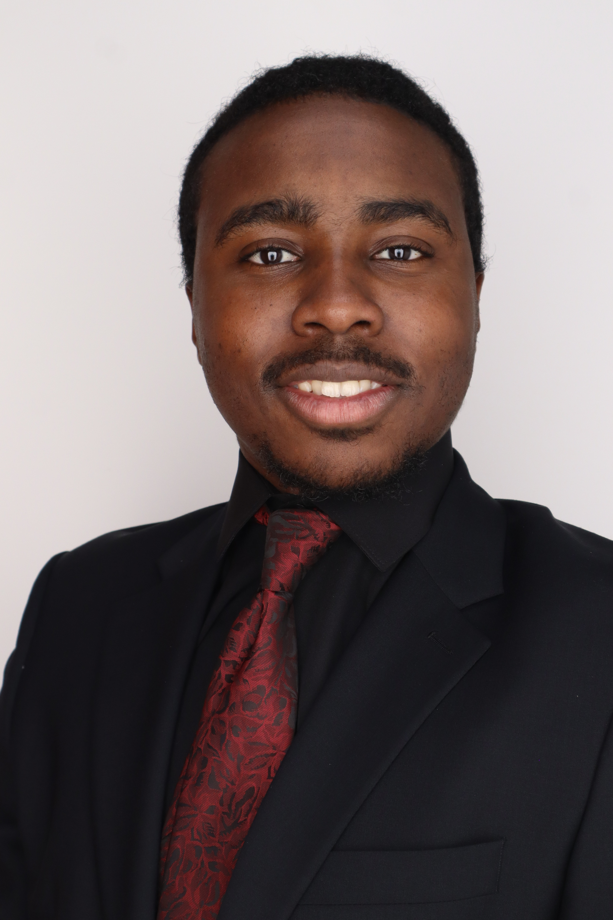
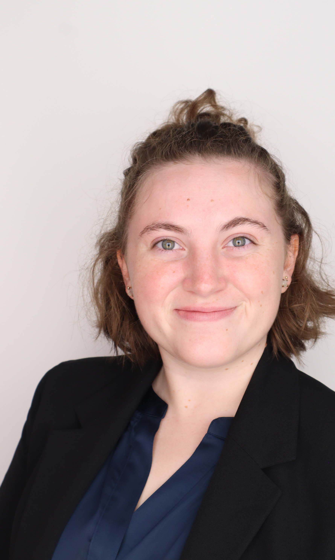
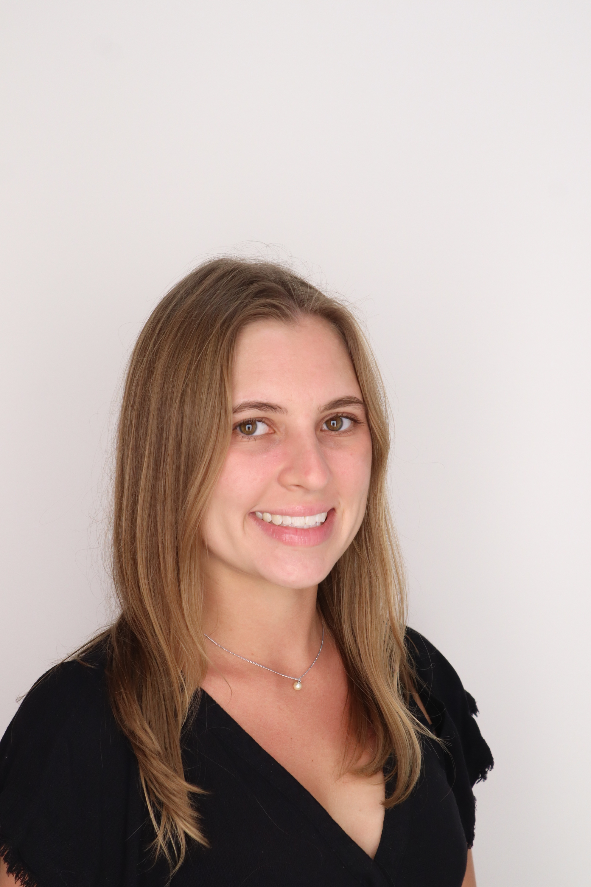
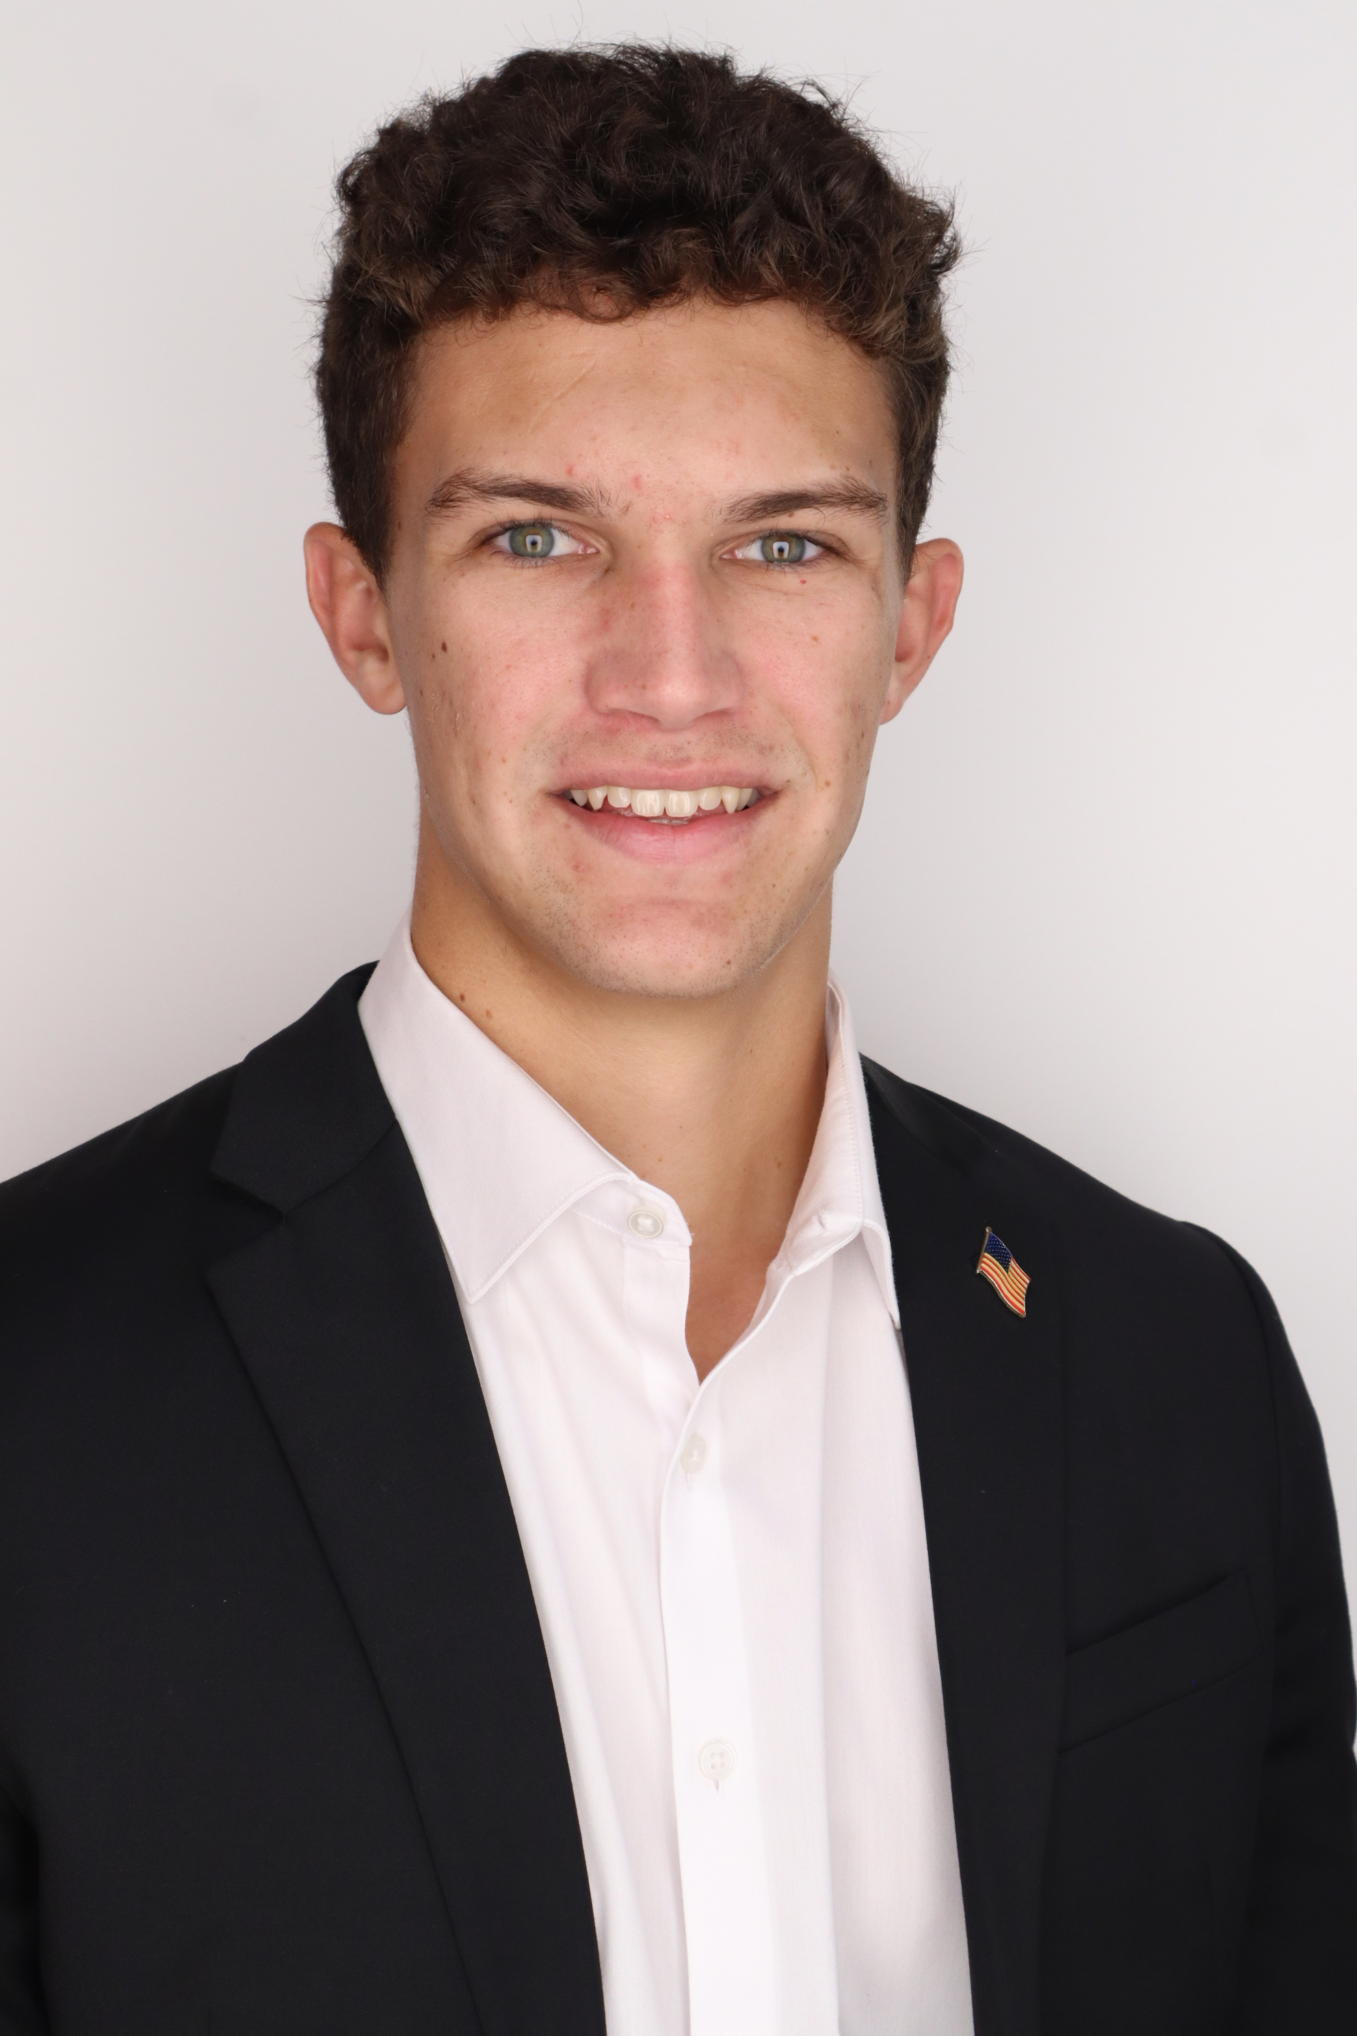
Introduction – Team 520
John Baumann
John Baumann
Design Engineer
Cody Carlson
Software Engineer
Malik Jean-Baptiste
Robotics Engineer
Natalie Boggess
Marine Engineer
Megan Jadush
Materials Engineer
Anders Snell
Mechatronics
Engineer

Slide 4
Project Objective
John Baumann
The objective of this project is to create a system capable of recording a diver’s position while submerged.

Slide 5
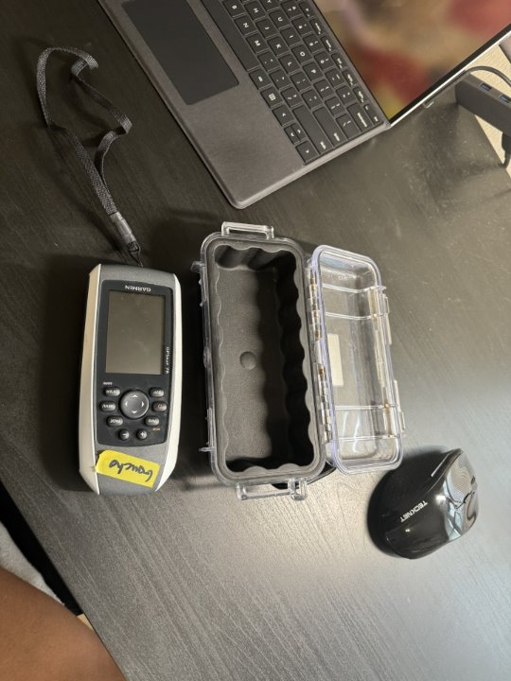
Project Summary
John Baumann
Dr. Rassweiler SCUBA dives and plots diseased corals on his map
Current system: location is within a 10m radius circle, wants to get more precise

Slide 6



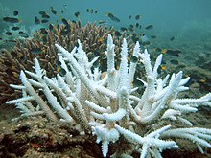






Overview
John Baumann
Error
GPS
Dr. Rassweiler SCUBA dives and plots diseased corals on his map post dive, but the current method is not accurate

Slide 7


Background
John Baumann
GPS is incapable of penetrating through water
Relies on radio waves
Buoys will drift due to waves and current
Will be operating at up to 10m underwater
Can approximate a right triangle for diver position
Horizontal distance between diver and surface device is needed

Slide 8
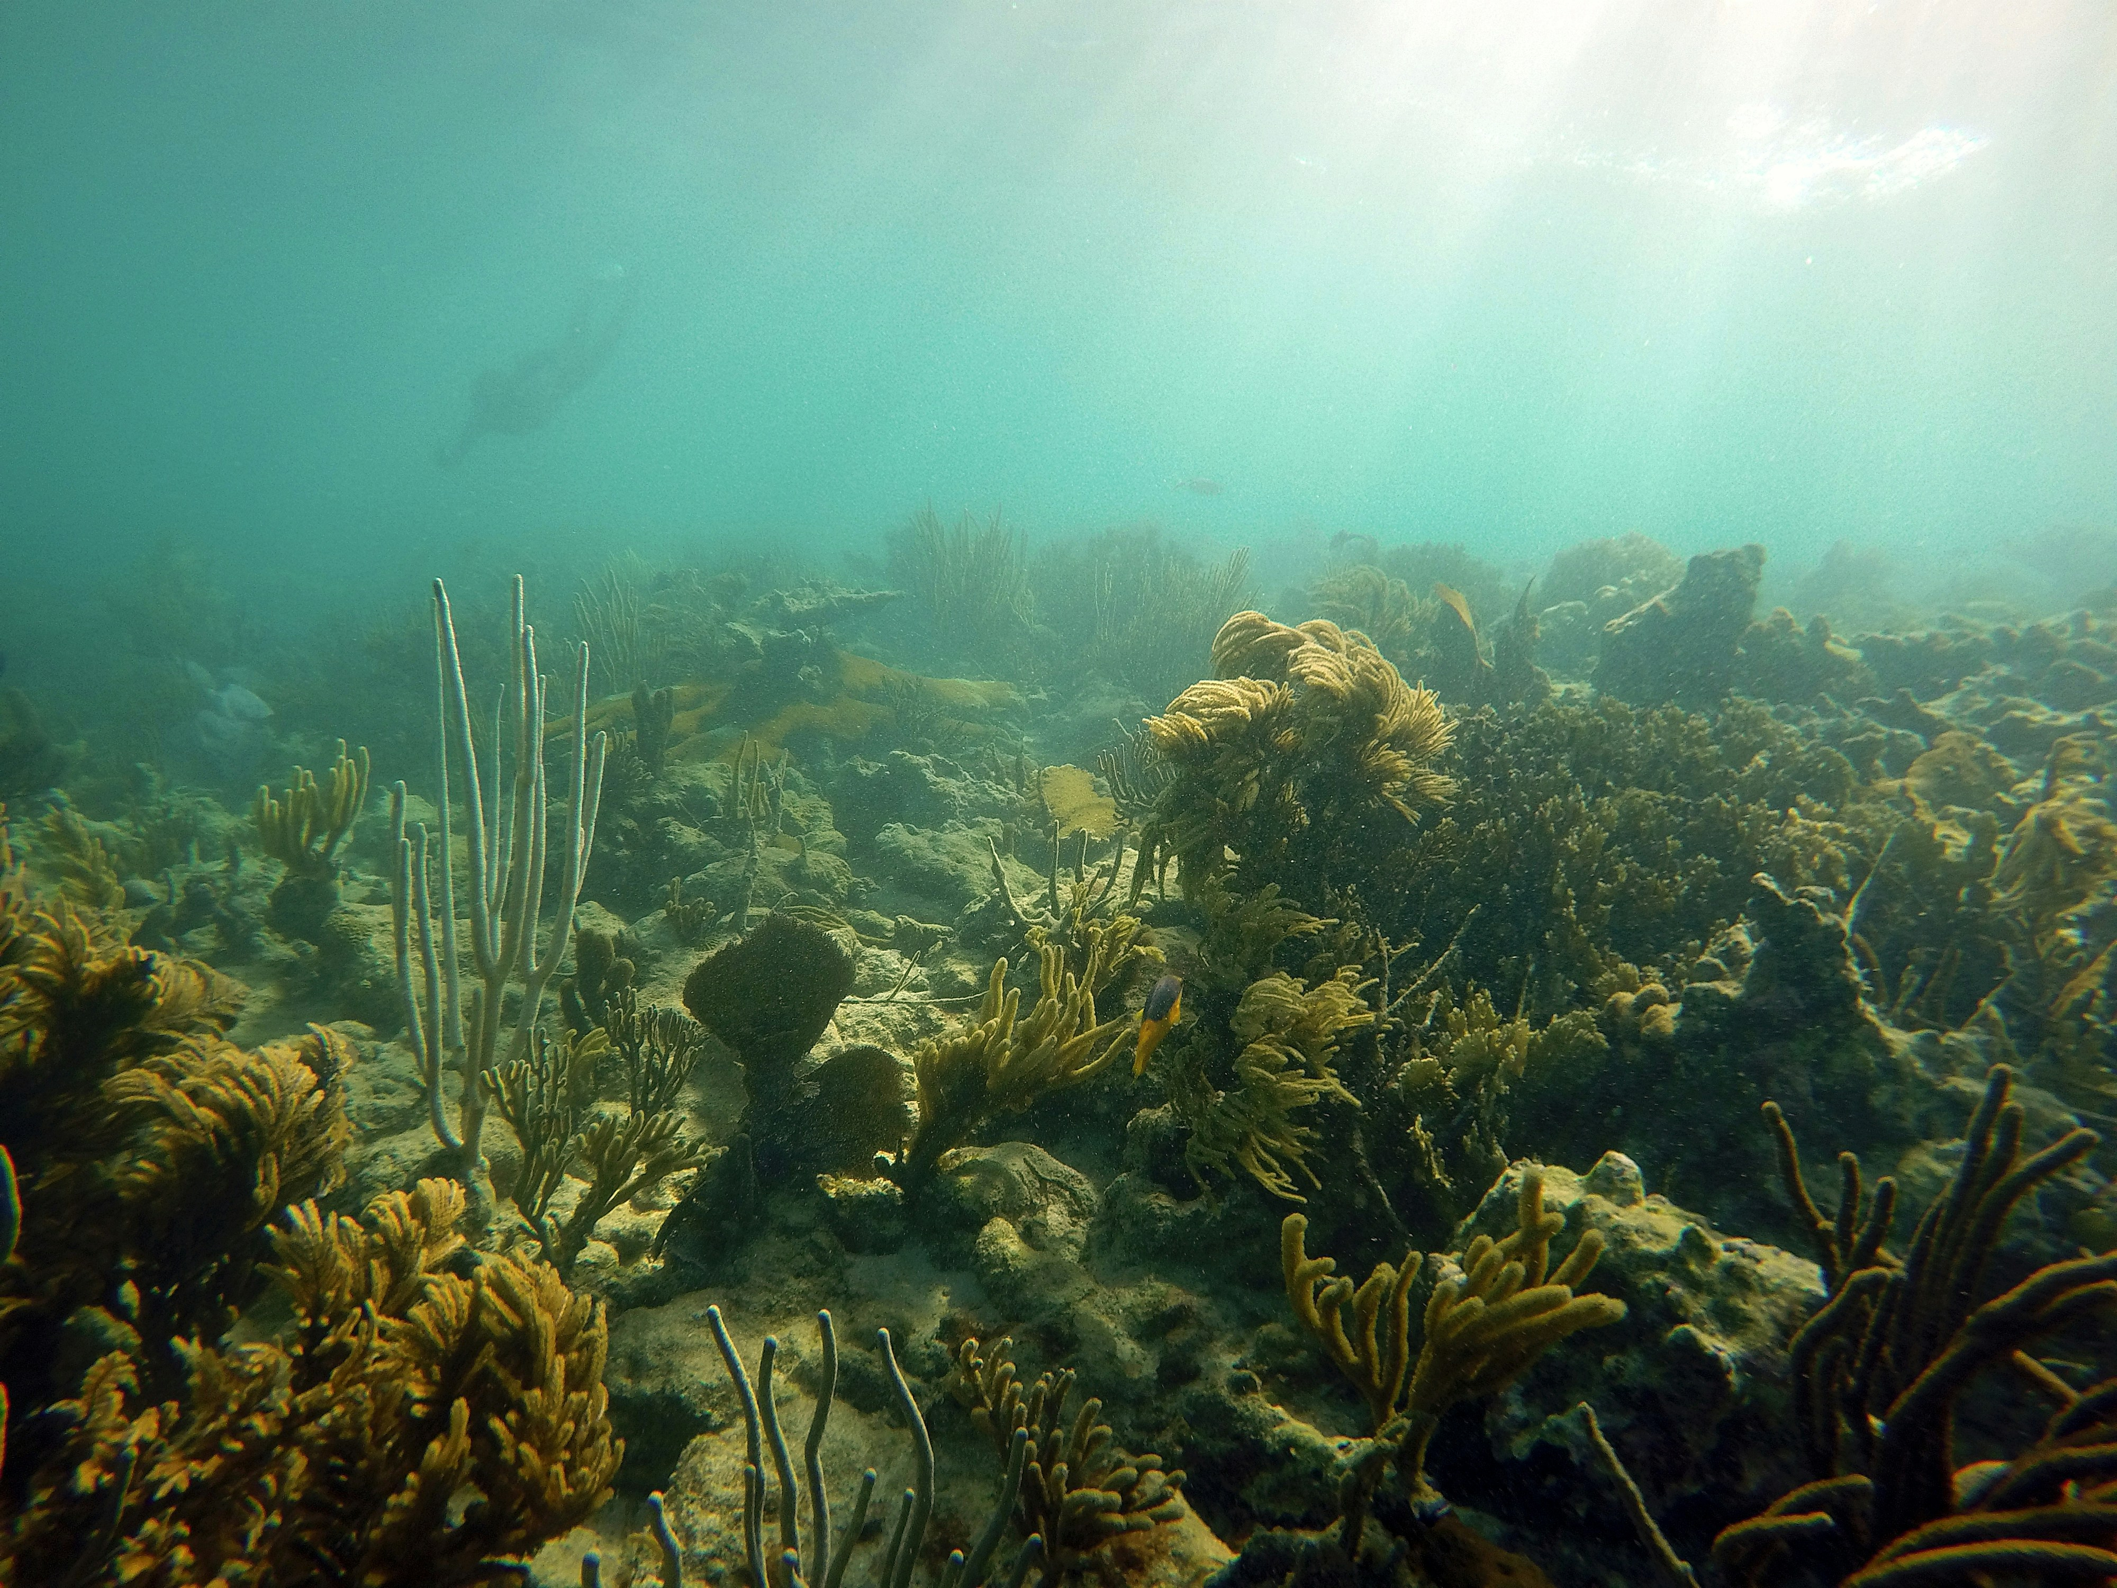
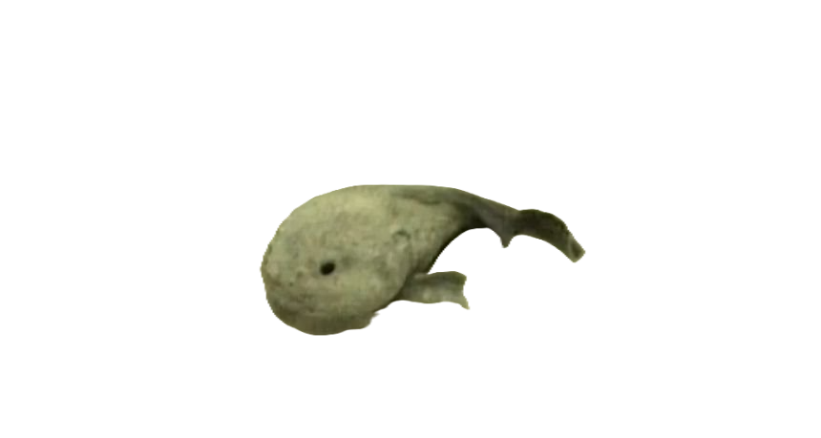
What This Is All For
John Baumann

Slide 9




Assumptions
John Baumann
The user will be within 10 meters of the water's surface.
The user has access to a watch and a waterproof notepad.
The max duration of each dive will be no longer than 90 minutes.
  Weather conditions will consist of wind (15-20 knots),
  small waves (2-3 feet), and a water temperature of around
  82°F.

Slide 10
Key Goals
John Baumann
The system will be able to reliably work at a depth underwater up to 10 meters
Pinpoint diver's position within 6 m. diameter
The system will be portable, capable of launching from the shore, and require minimal setup
The system's power should last at least 90 minutes at a time

Slide 11
Functional Decomposition
John Baumann
Underwater Tracking System
Sensor
Power Source
Structure
Data

Slide 12
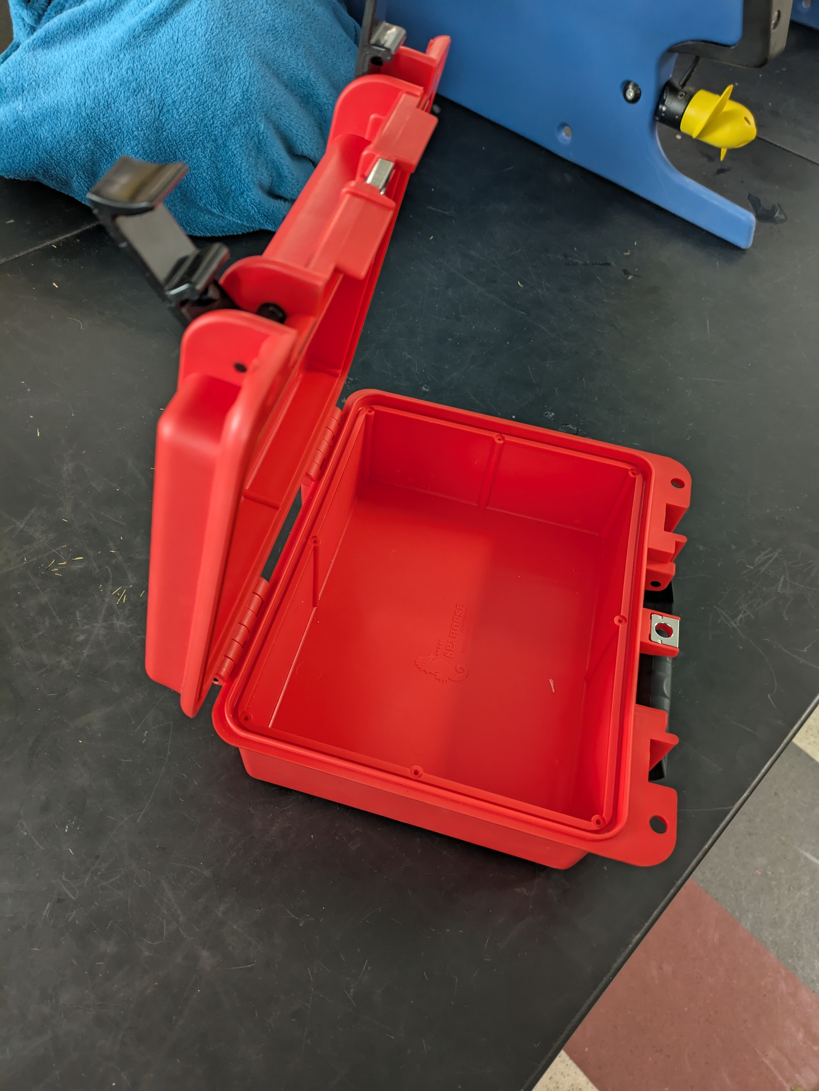
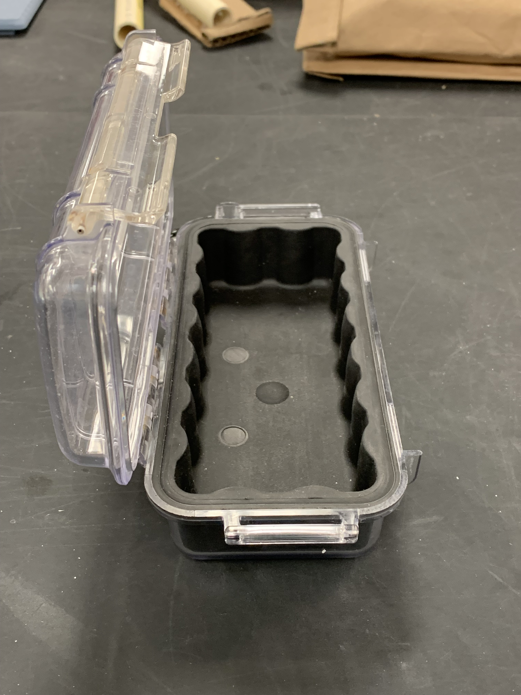
Structure Changes
Cody Carlson
Above Surface System

Slide 13
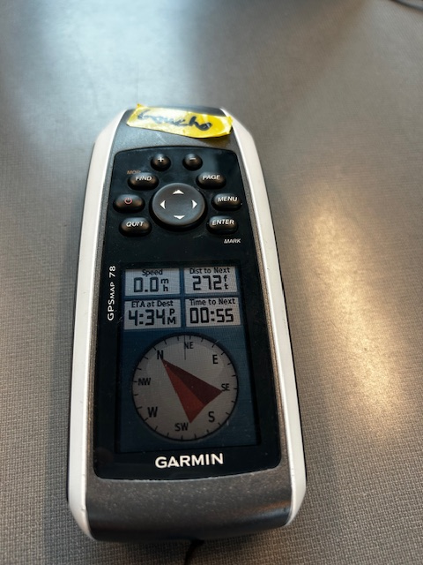


Technology
Cody Carlson
Global Positioning System (GPS)
Compass
Positioning data from satellites used to correct cumulative positional errors (drift) of the system

Slide 14
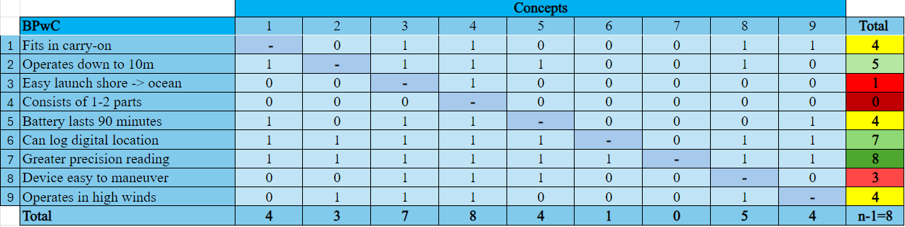
Concept Selection
Cody Carlson
Table 1: Binary Pairwise Comparison Matrix

Slide 15
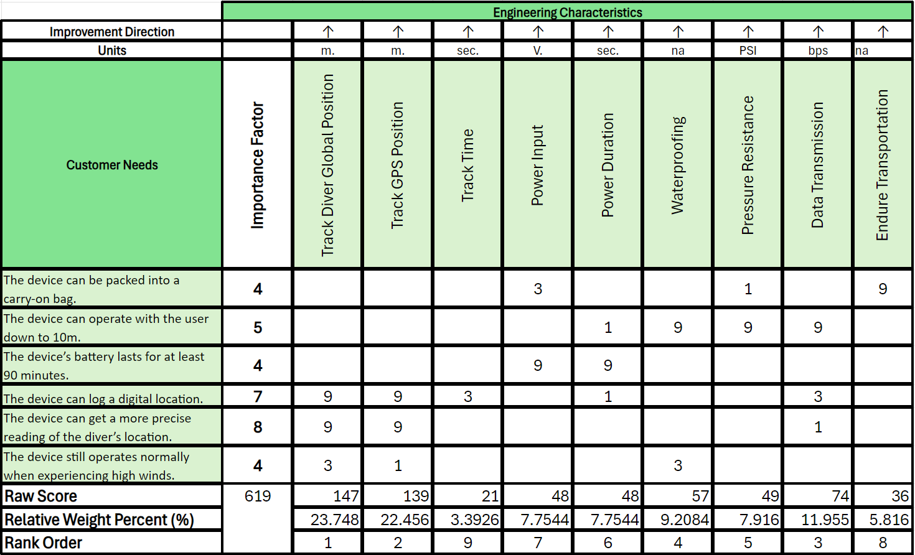
Concept Selection
Cody Carlson

Slide 16
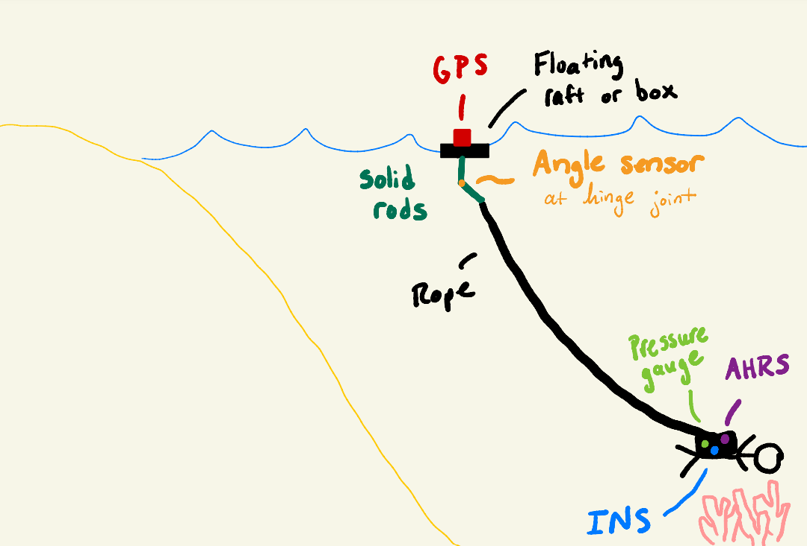
Chosen Design: Concept 61
Cody Carlson

Slide 17
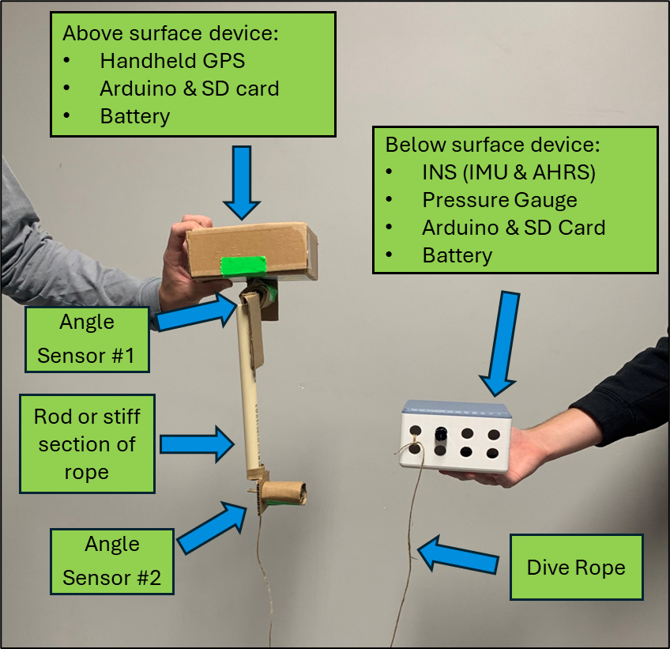
First Prototype
Cody Carlson

Slide 18
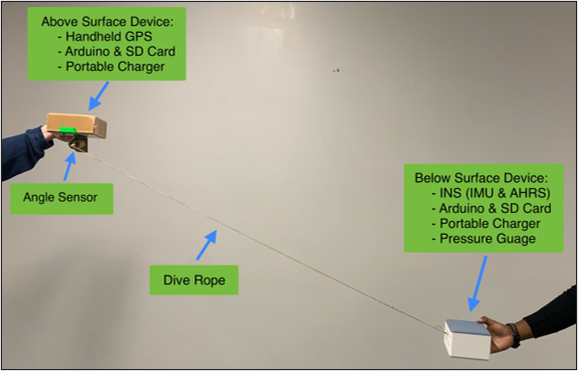
Second Prototype
Cody Carlson

Slide 19
Current Prototype
Cody Carlson
Water-tight surface box:
GPS
Arduino & SD Card
Portable charger
Snap-on mounting bracket
Angle sensor or automatic reel
Dive rope
Fins

Slide 20
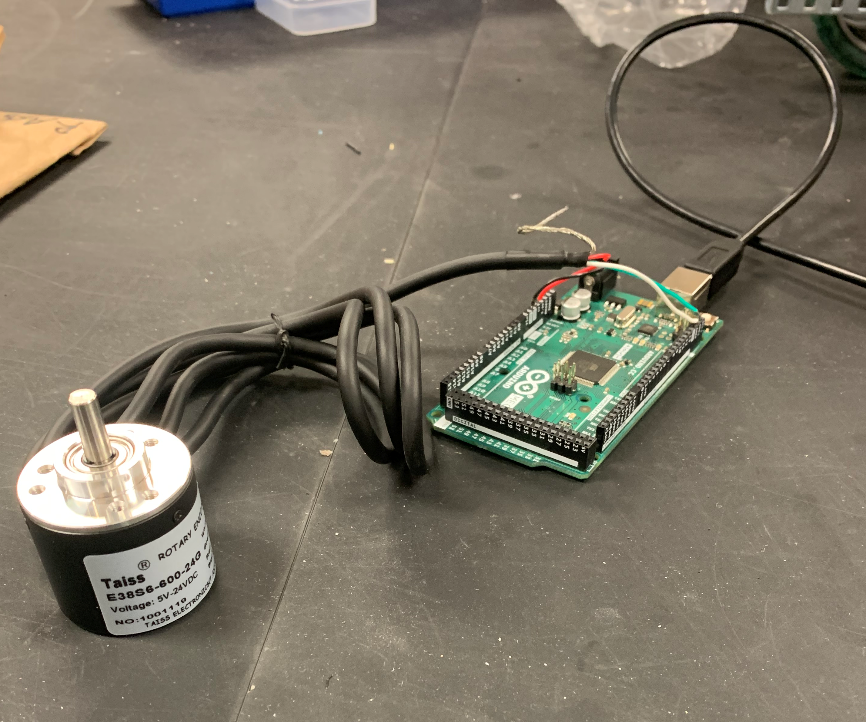
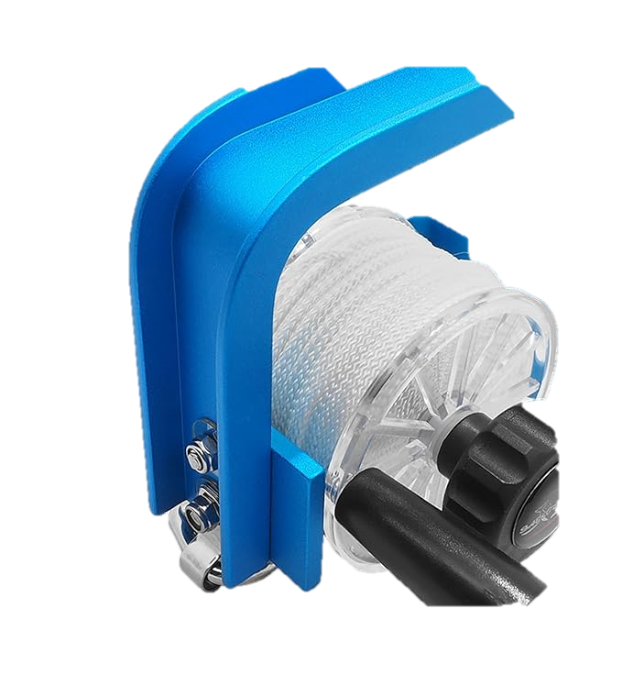
Decisions Moving Forward
Cody Carlson
VS
Image 1: Reel [6]

Slide 21
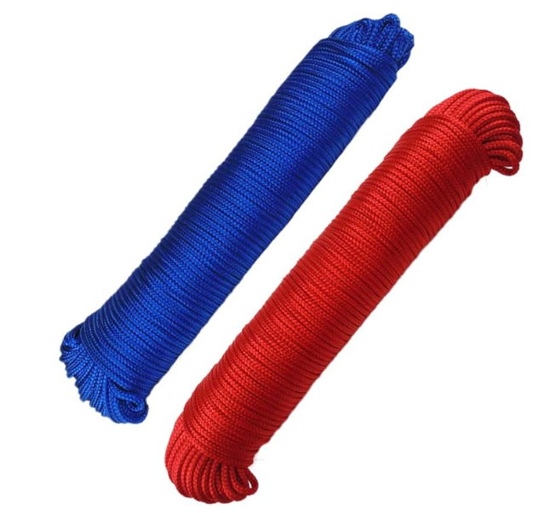
Dive Rope
Cody Carlson
Image 2: Dive Rope [7]

Slide 22
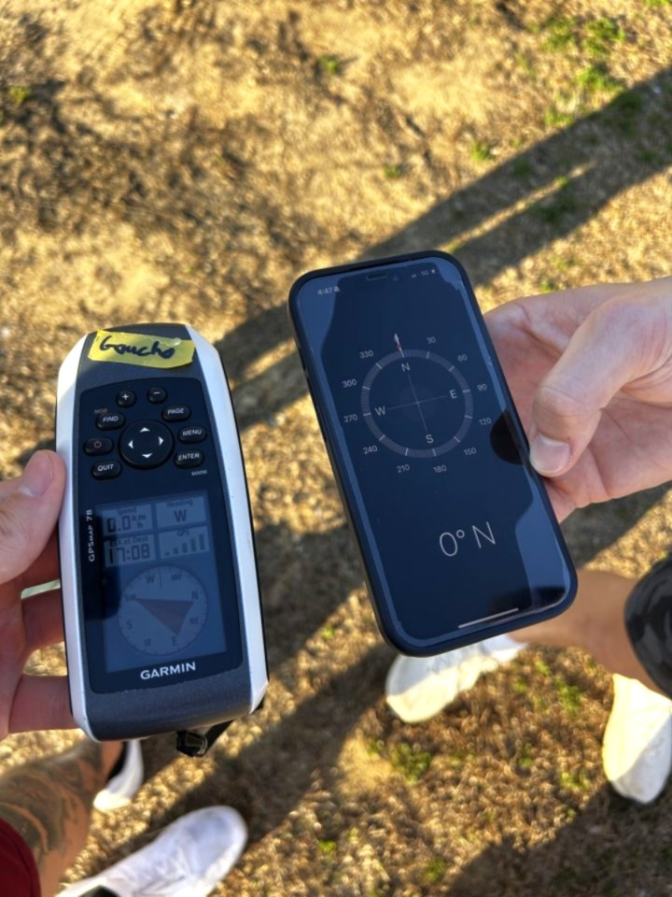
Current GPS
Cody Carlson
Does not display correct heading
Very choppy when updating
Delayed from user

Slide 23
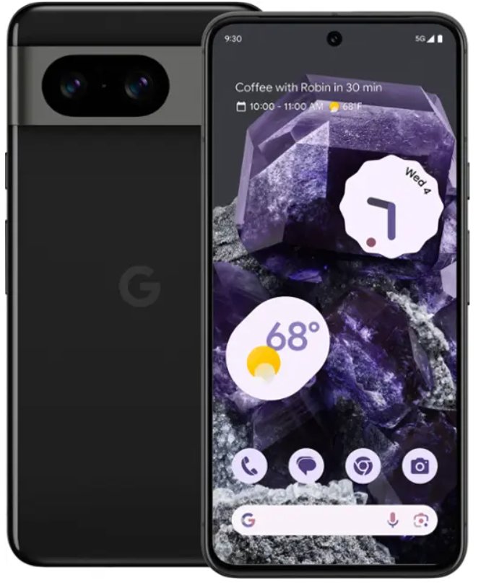
New System
Cody Carlson

Slide 24
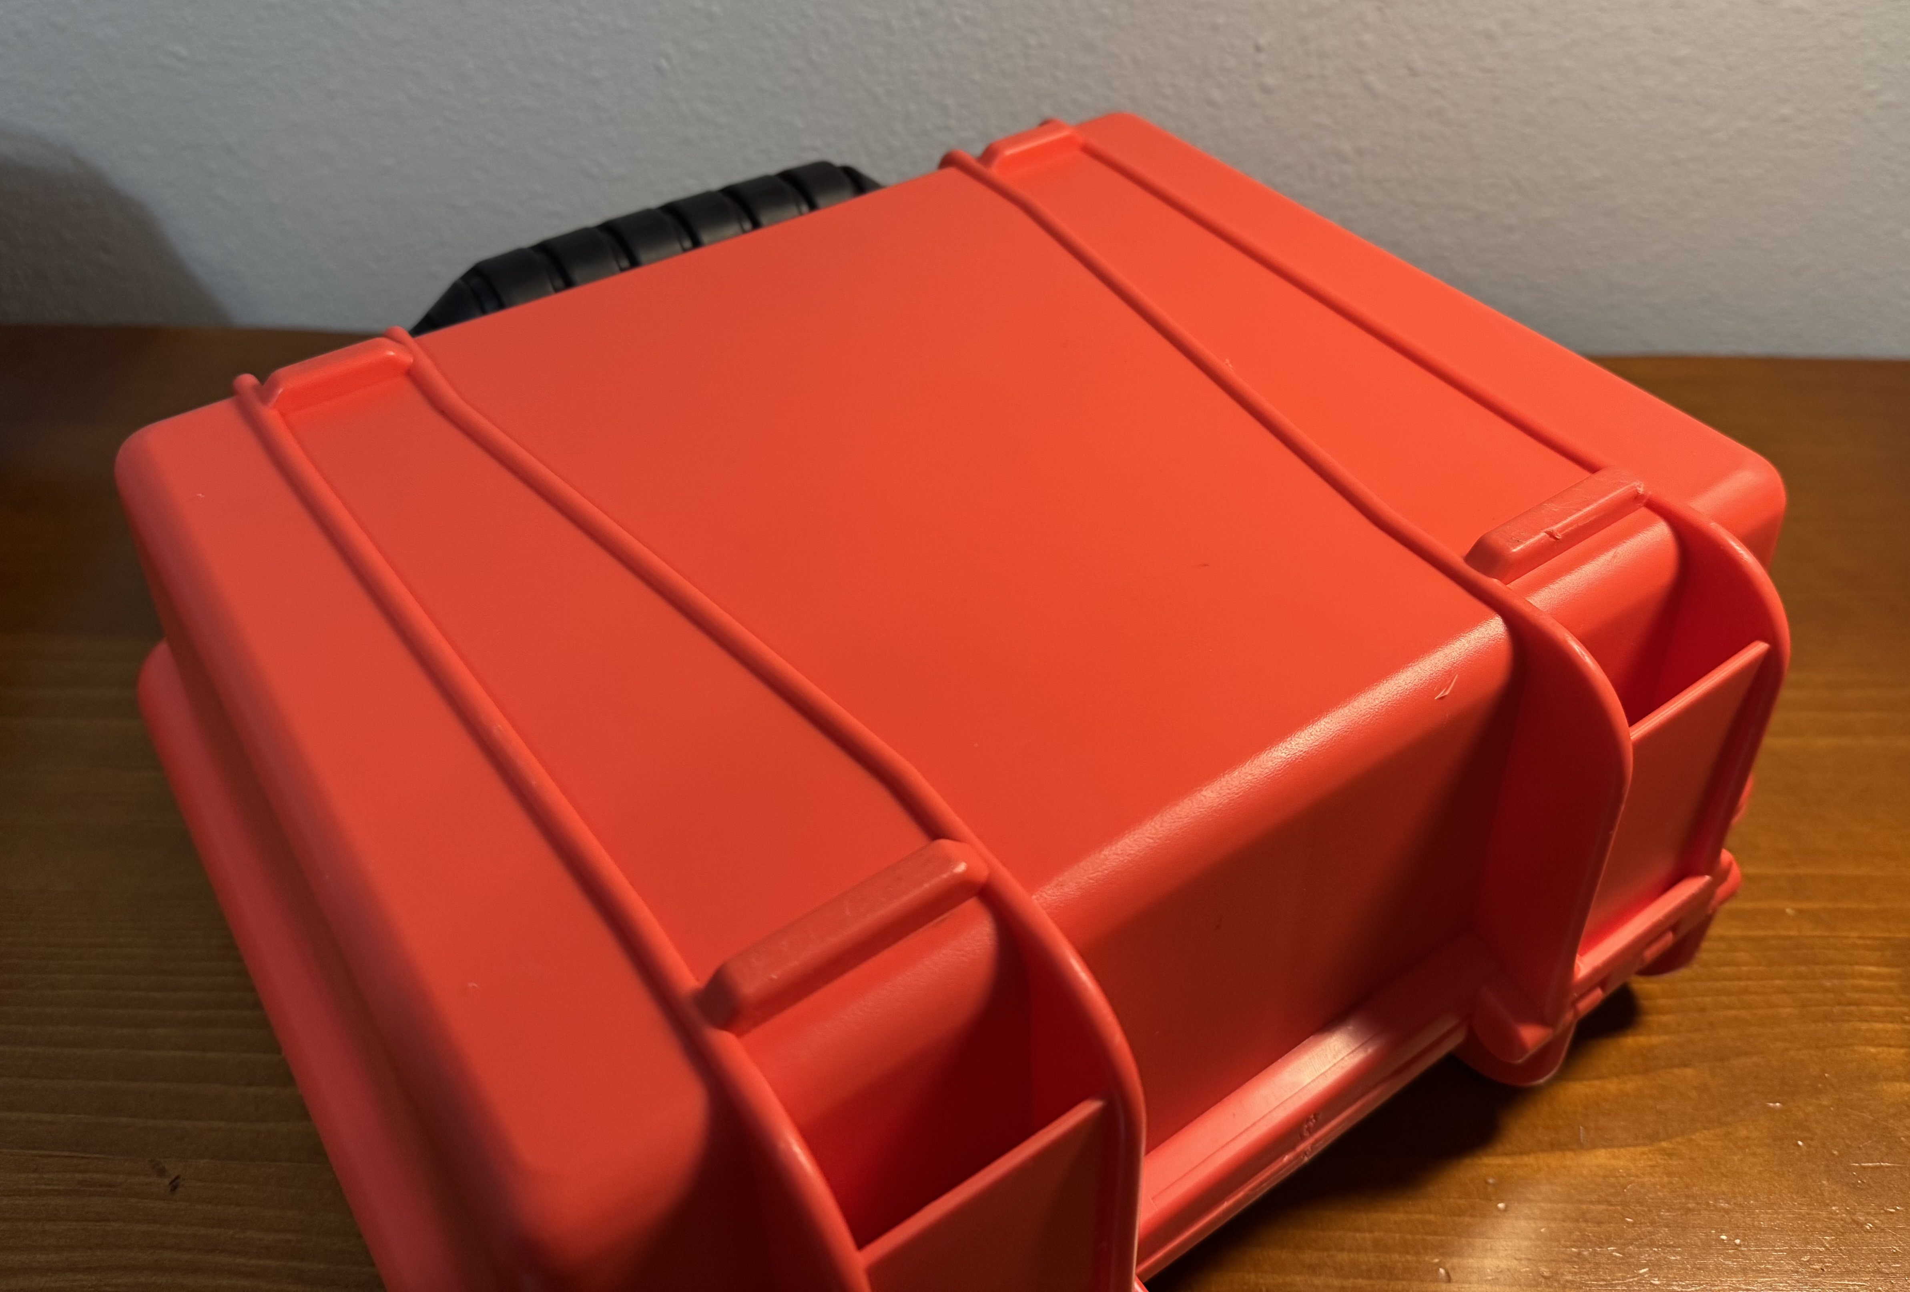
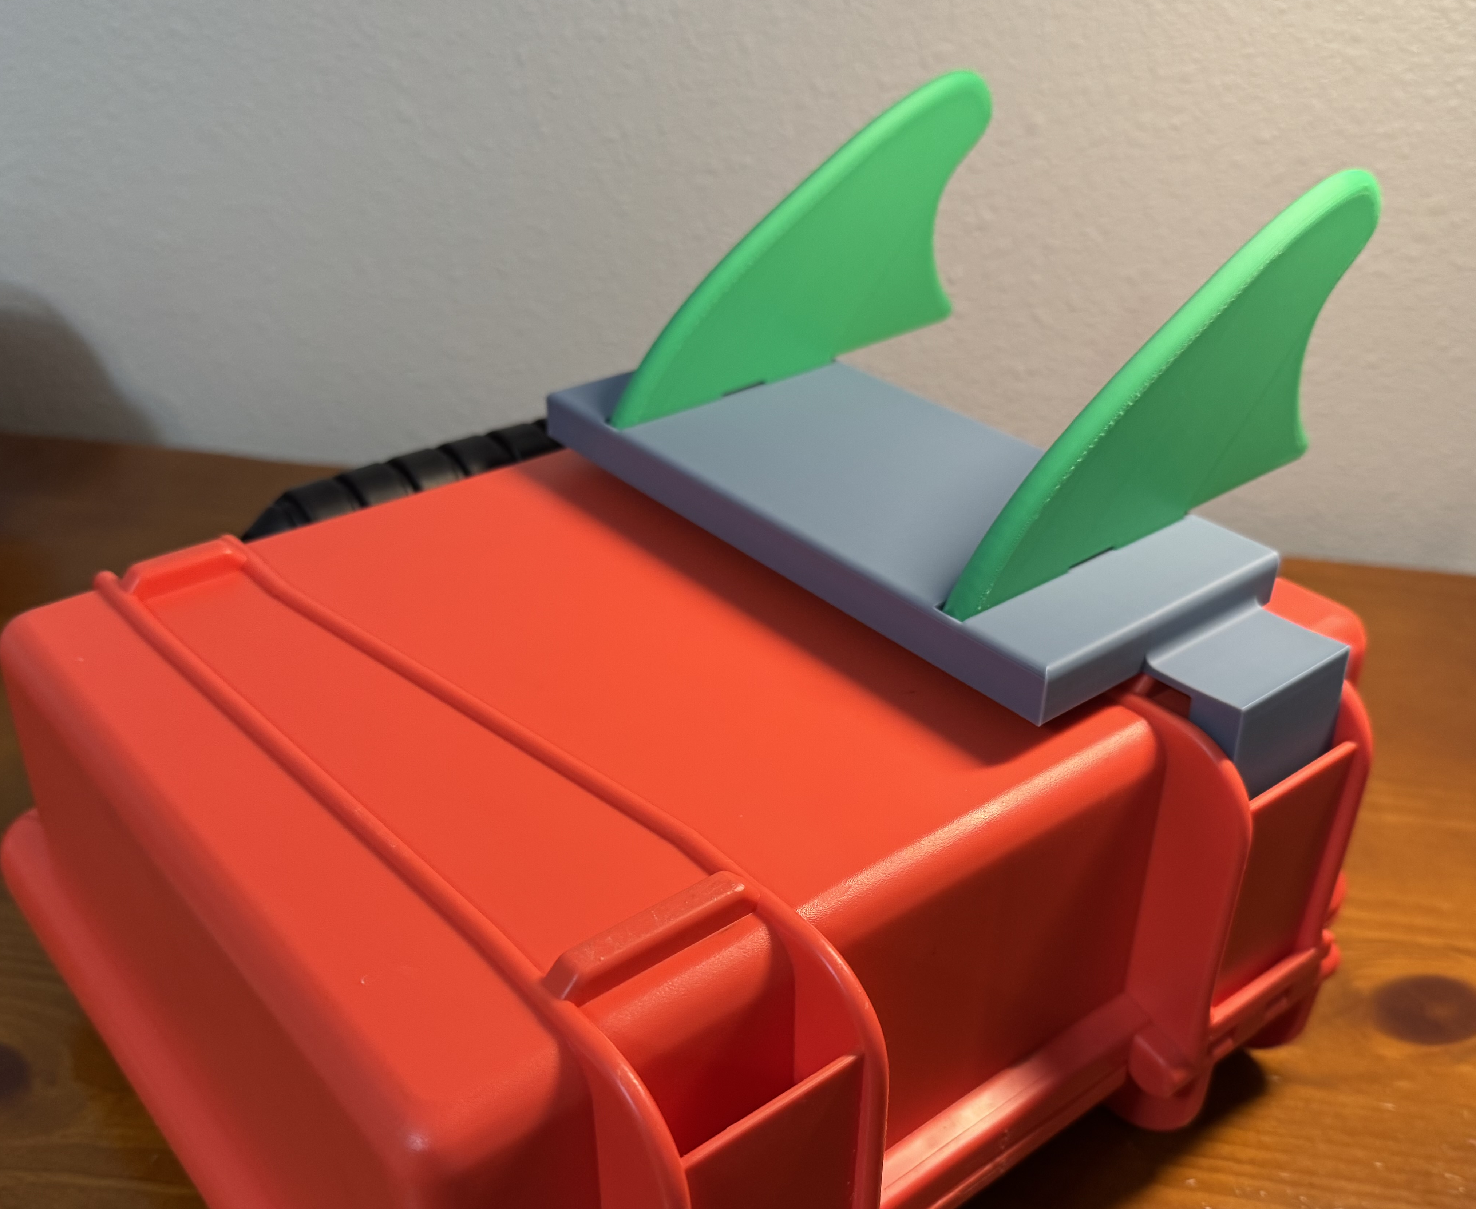
Mounting
Anders Snell

Slide 25
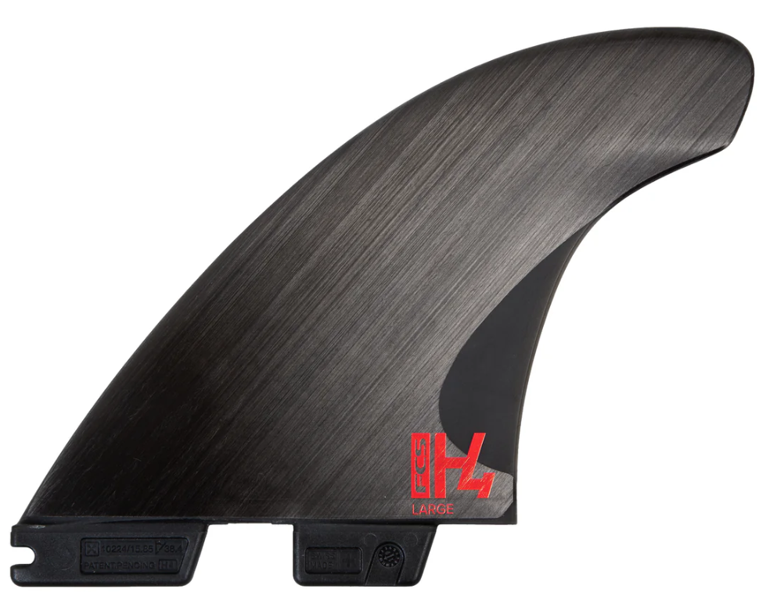
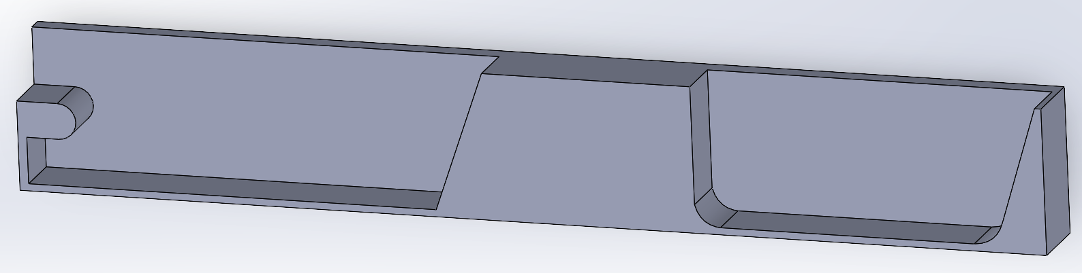
Mounting – Modular System
Anders Snell
Can be used for fins, rotary encoder, or line reel

Slide 26

Testing
Anders Snell
Mini Pool

Slide 27
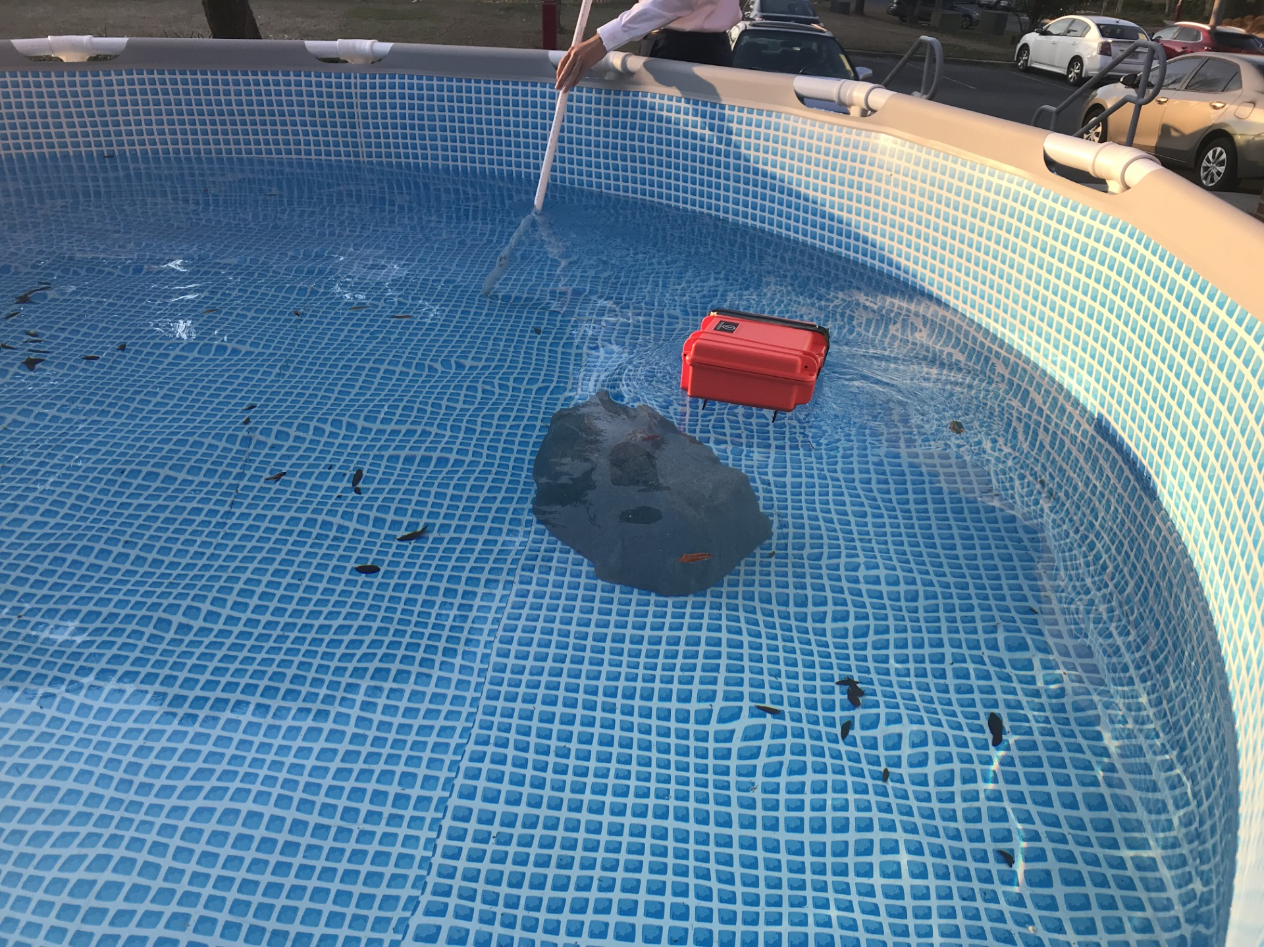
Mini Pool Testing
Anders Snell
Tested stability and the watertight O-ring of the system with and without fins in a 4-foot-deep pool

Slide 28
Testing
Anders Snell
Mini Pool
Morcom Aquatic Center
Springs/Ocean

Slide 29
Testing Question
Anders Snell
OR

Slide 30



Waterproofing
Anders Snell
Waterproof up to 1 m
This lasts 30 mins
Rotary encoder – rotary seal
Line measurer/tensioner
Epoxy to fill gaps

Slide 31
Software
Anders Snell
Parses time-stamped latitude, longitude, and orientation data
Time, depth and line length of point of interest inputted
Calculates latitude and longitude displacement
Resultant coordinates outputted

Slide 32
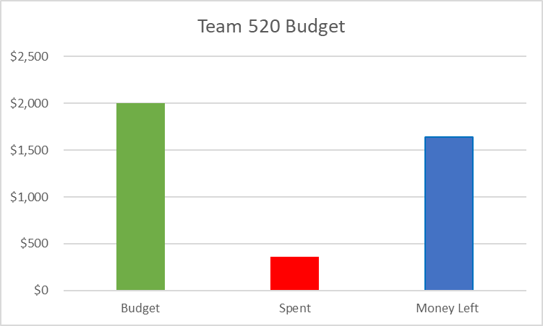
Project Budget
Anders Snell
$1640.07
$359.93

Slide 33
References
Anders Snell
[1] What is an Inertial Measurement Unit? (2024). VectorNav. https://www.vectornav.com/resources/detail/what-is-an-inertial-measurement-unit
[2] Garmin GPSMAP 78 Handheld Navigator - 010-00864-00. (2024). Marine Electronics Shop. https://www.marine-electronics-shop.com/garmin-gpsmap-78-handheld-navigator-010-00864-00/
[3] Bar02 Ultra High Resolution 10m Depth/Pressure Sensor. (n.d.). Blue Robotics. https://bluerobotics.com/store/sensors-cameras/sensors/bar02-sensor-r1-rp/
[4] SparkFun OpenLog Artemis - DEV-16832 - SparkFun Electronics. (2022, November 5). Sparkfun.com. https://www.sparkfun.com/products/16832
[5] Blue Robotics Watertight Box – Blue Robotics. (2024, April 30). BlueRobotics.com
https://bluerobotics.com/store/watertight-enclosures/watertight-boxes/watertight-box/
[6] 150ft Aluminum Dive Reel with Tension and Locking System - Rope Reel, Scuba Diving Reel, Kayak Anchor Reel, String Line Reel –Amazon https://www.amazon.com/SAEKODIVE-Aluminum-Tension-Locking-System/dp/B0CQ8FSPSV

Slide 34
Current/Future Work
Anders Snell
Buying and testing a reeling system
Compare reel and angle sensor results
Work on coding different components together
Testing system in deeper pool/ spring, or ocean
Designing and testing a completely external mounting system
Waterproofing any connections needed

Slide 35
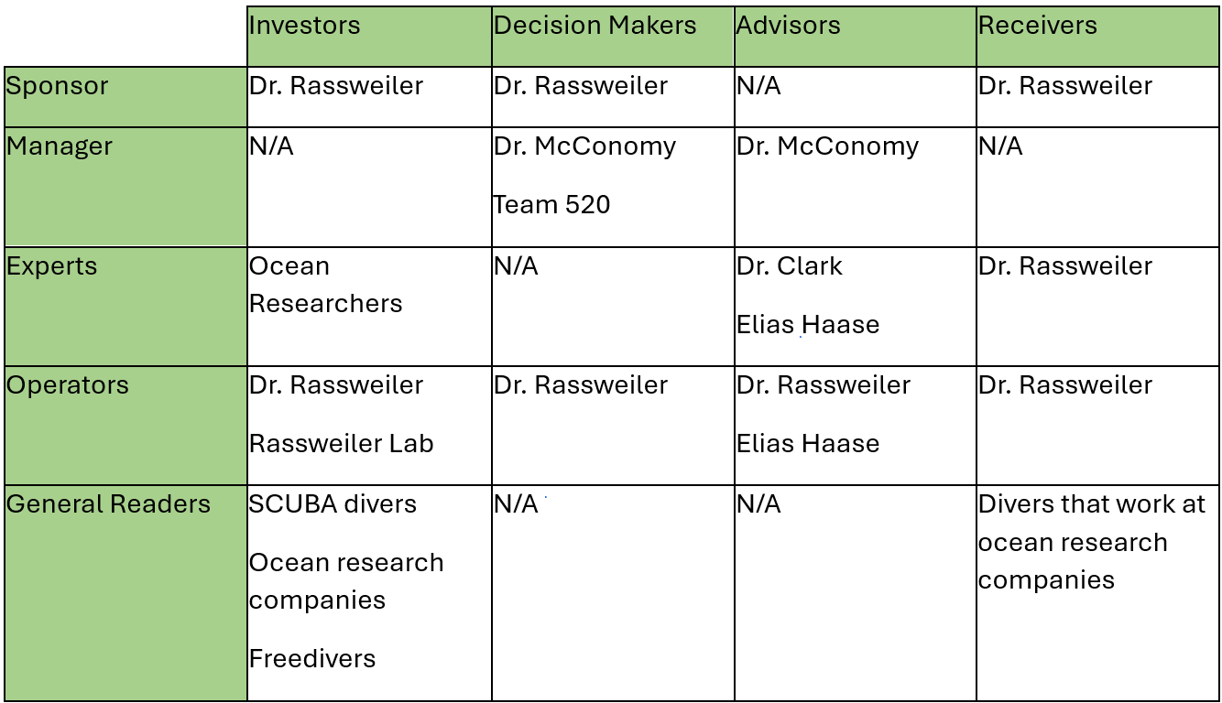
Stakeholder Matrix

Slide 36

Stakeholders
Natalie Boggess
Dr. Andrew Rassweiler
Investor, Decision Maker, Receiver
Rassweiler Laboratory
Operator
Dr. Shayne McConomy
Manager
Dr. Jonathan Clark
Expert
RL

Slide 37


Primary Market
Malik Jean Baptiste
Dr. Rassweiler
Oceanographers

Slide 38




Secondary Market
Malik Jean Baptiste
Commercial Fishing
Underwater Exploration
Recreational Divers
Marine Sanctuary

Slide 39
House of Quality
Cody Carlson
Track Diver Global Position
Track GPS Position
Data Transmission
Waterproofing
HoQ
Pressure Resistance

Slide 40
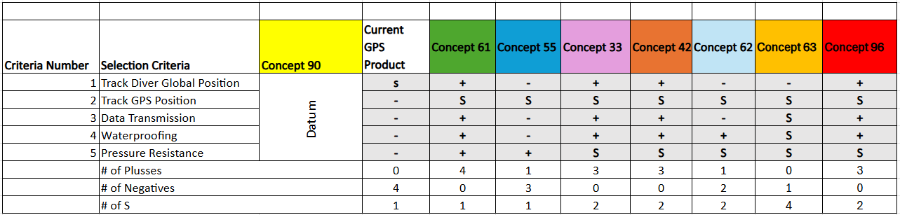
Pugh Chart Iteration

Slide 41
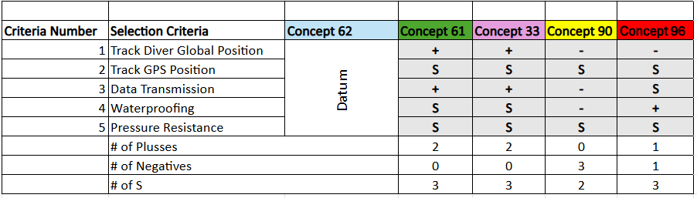
Concept Selection

Slide 42
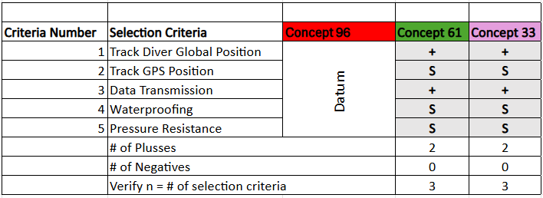
Concept Selection
Cody Carlson

Slide 43
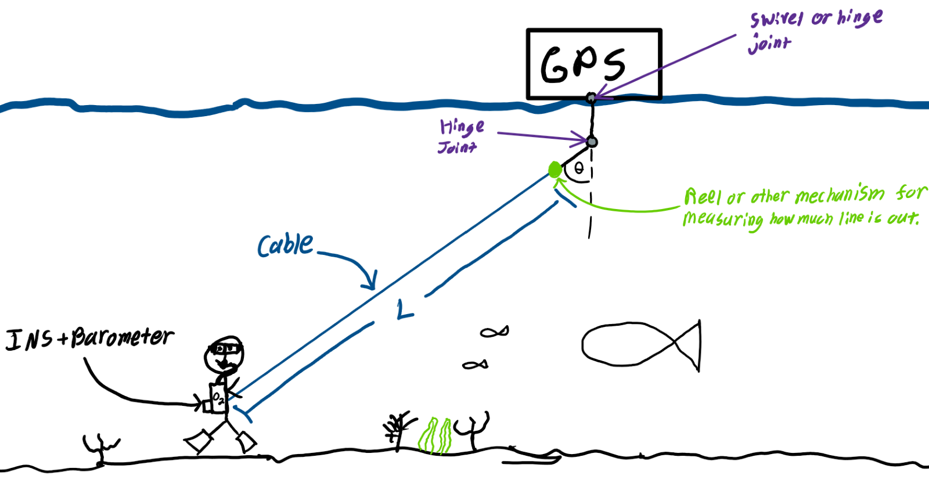
First High Fidelity Concept #33
Natalie Boggess
Inertial Navigation System (INS)
Barometer
Angle sensor
GPS
Cable instead of rope
Measurement of cable length

Slide 44
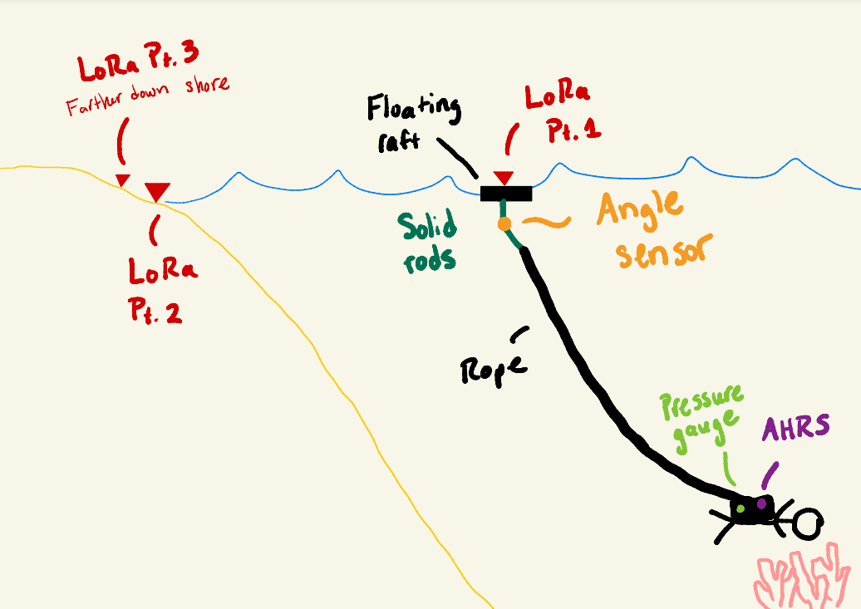
Second High Fidelity Concept #55
Natalie Boggess
Long range radio communication (LoRa) triangular positioning technology
  Two nodes on shore and one on the ocean
Attitude & heading reference system (AHRS)
Angle sensors

Slide 45
Third High Fidelity Concept #61
Natalie Boggess
Inertial navigation system (INS)
Angle sensors
Attitude & heading reference system (AHRS)
GPS secured in a floating raft

Slide 46
Customer Needs
Natalie Boggess
The device still operates normally when experiencing high winds.
The device is easy to carry straight from the shore into the ocean.
The device can log a digital location.
The device can operate with the user down to 10m.
The device’s battery lasts for at least 90 minutes.
The device can get a more precise reading of the diver’s location.
The device consists of 1 or 2 small pieces.
The device can be packed into a carry-on bag.

Slide 47
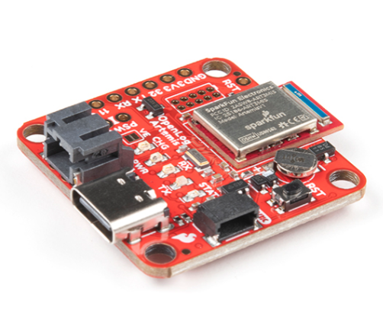
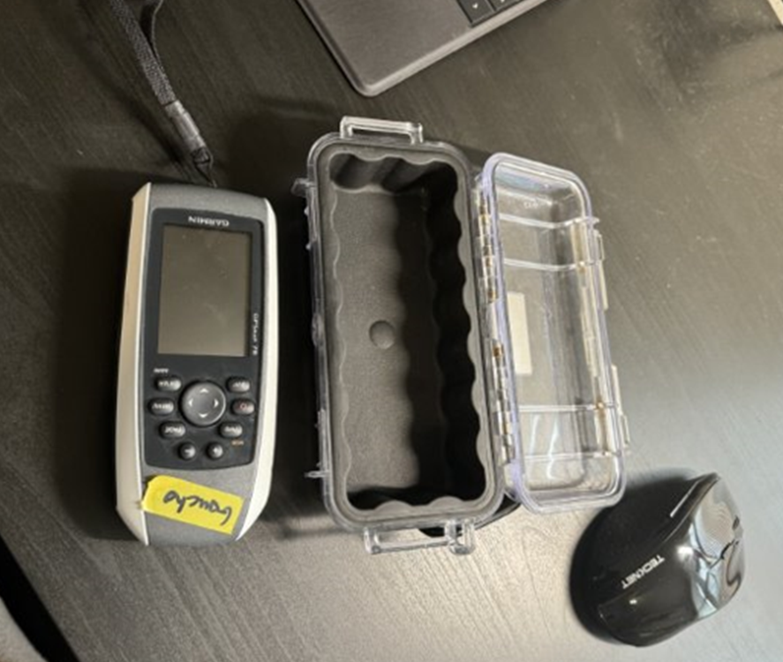
Inertial Navigation System (INS)
Natalie Boggess
Inertial Measurement Unit (IMU)
Attitude and Heading Reference System (AHRS)
Picture of INS goes here
Picture of INS goes here
Global Positioning System (GPS)
Global Positioning System (GPS)
Attitude and Heading Reference System (AHRS)
Linear accelerations and angular velocities are measured with accelerometers and gyroscopes
Orientation is determined with data from the IMU and a
magnetometer, ran through filter algorithms
Orientation is determined with data from the IMU and a
magnetometer, ran through filter algorithms
Positioning data from satellites used to correct cumulative positional errors (drift) of the system
Positioning data from satellites used to correct cumulative positional errors (drift) of the system
Figure 3: IMU + AHRS
Figure 4: GPS
20

Slide 48
Project Updates
Megan Jadush
Designed and implemented fins to device
Bought a new GPS and dive rope
Figure out how to attach a reel
Continuous Research
Tested device in a pool
Coordinated with Morcom Aquatics Center

Slide 49
Future Work Timeline
Megan Jadush
Got New Dive rope and test new Tensioner
Implement electronics to surface device
Designed and implemented fins to device
Continuous Research
Tested device in a pool
Coordinated with Morcom Aquatics Center

Slide 50
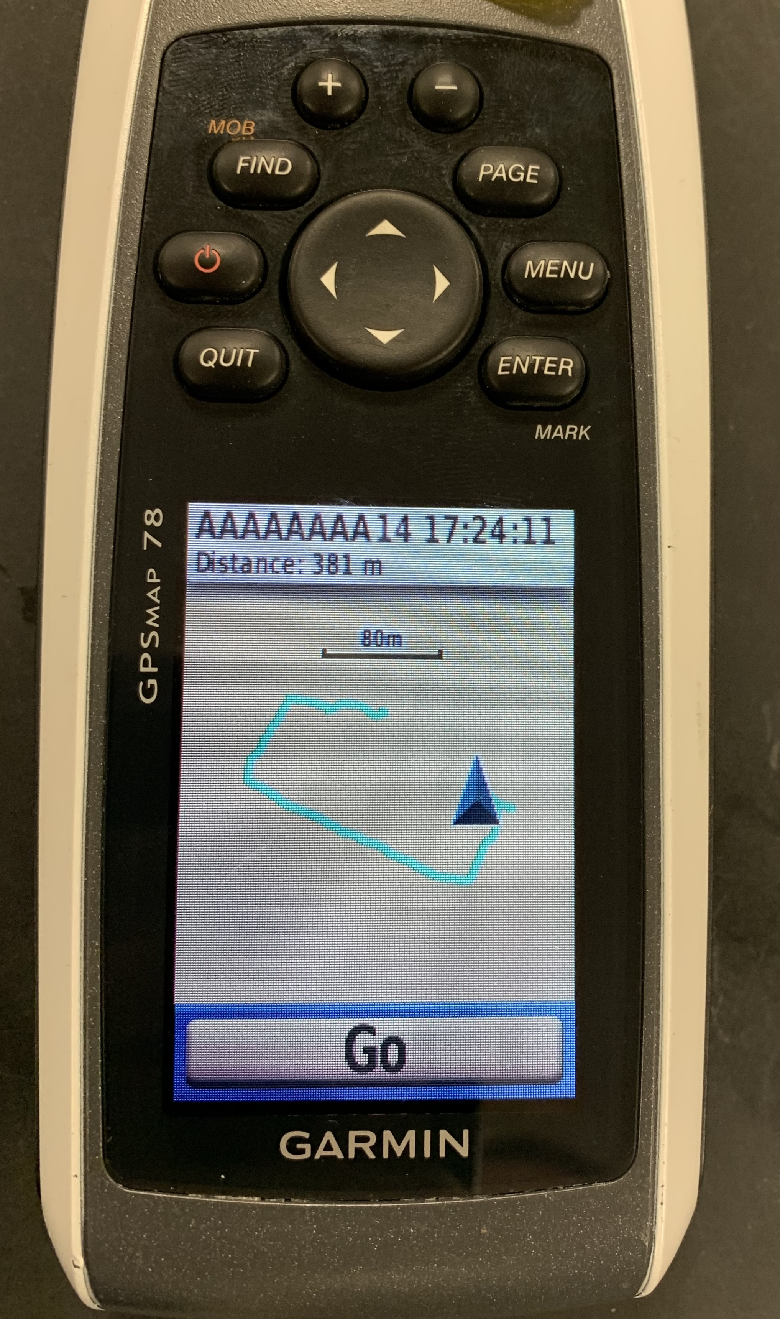
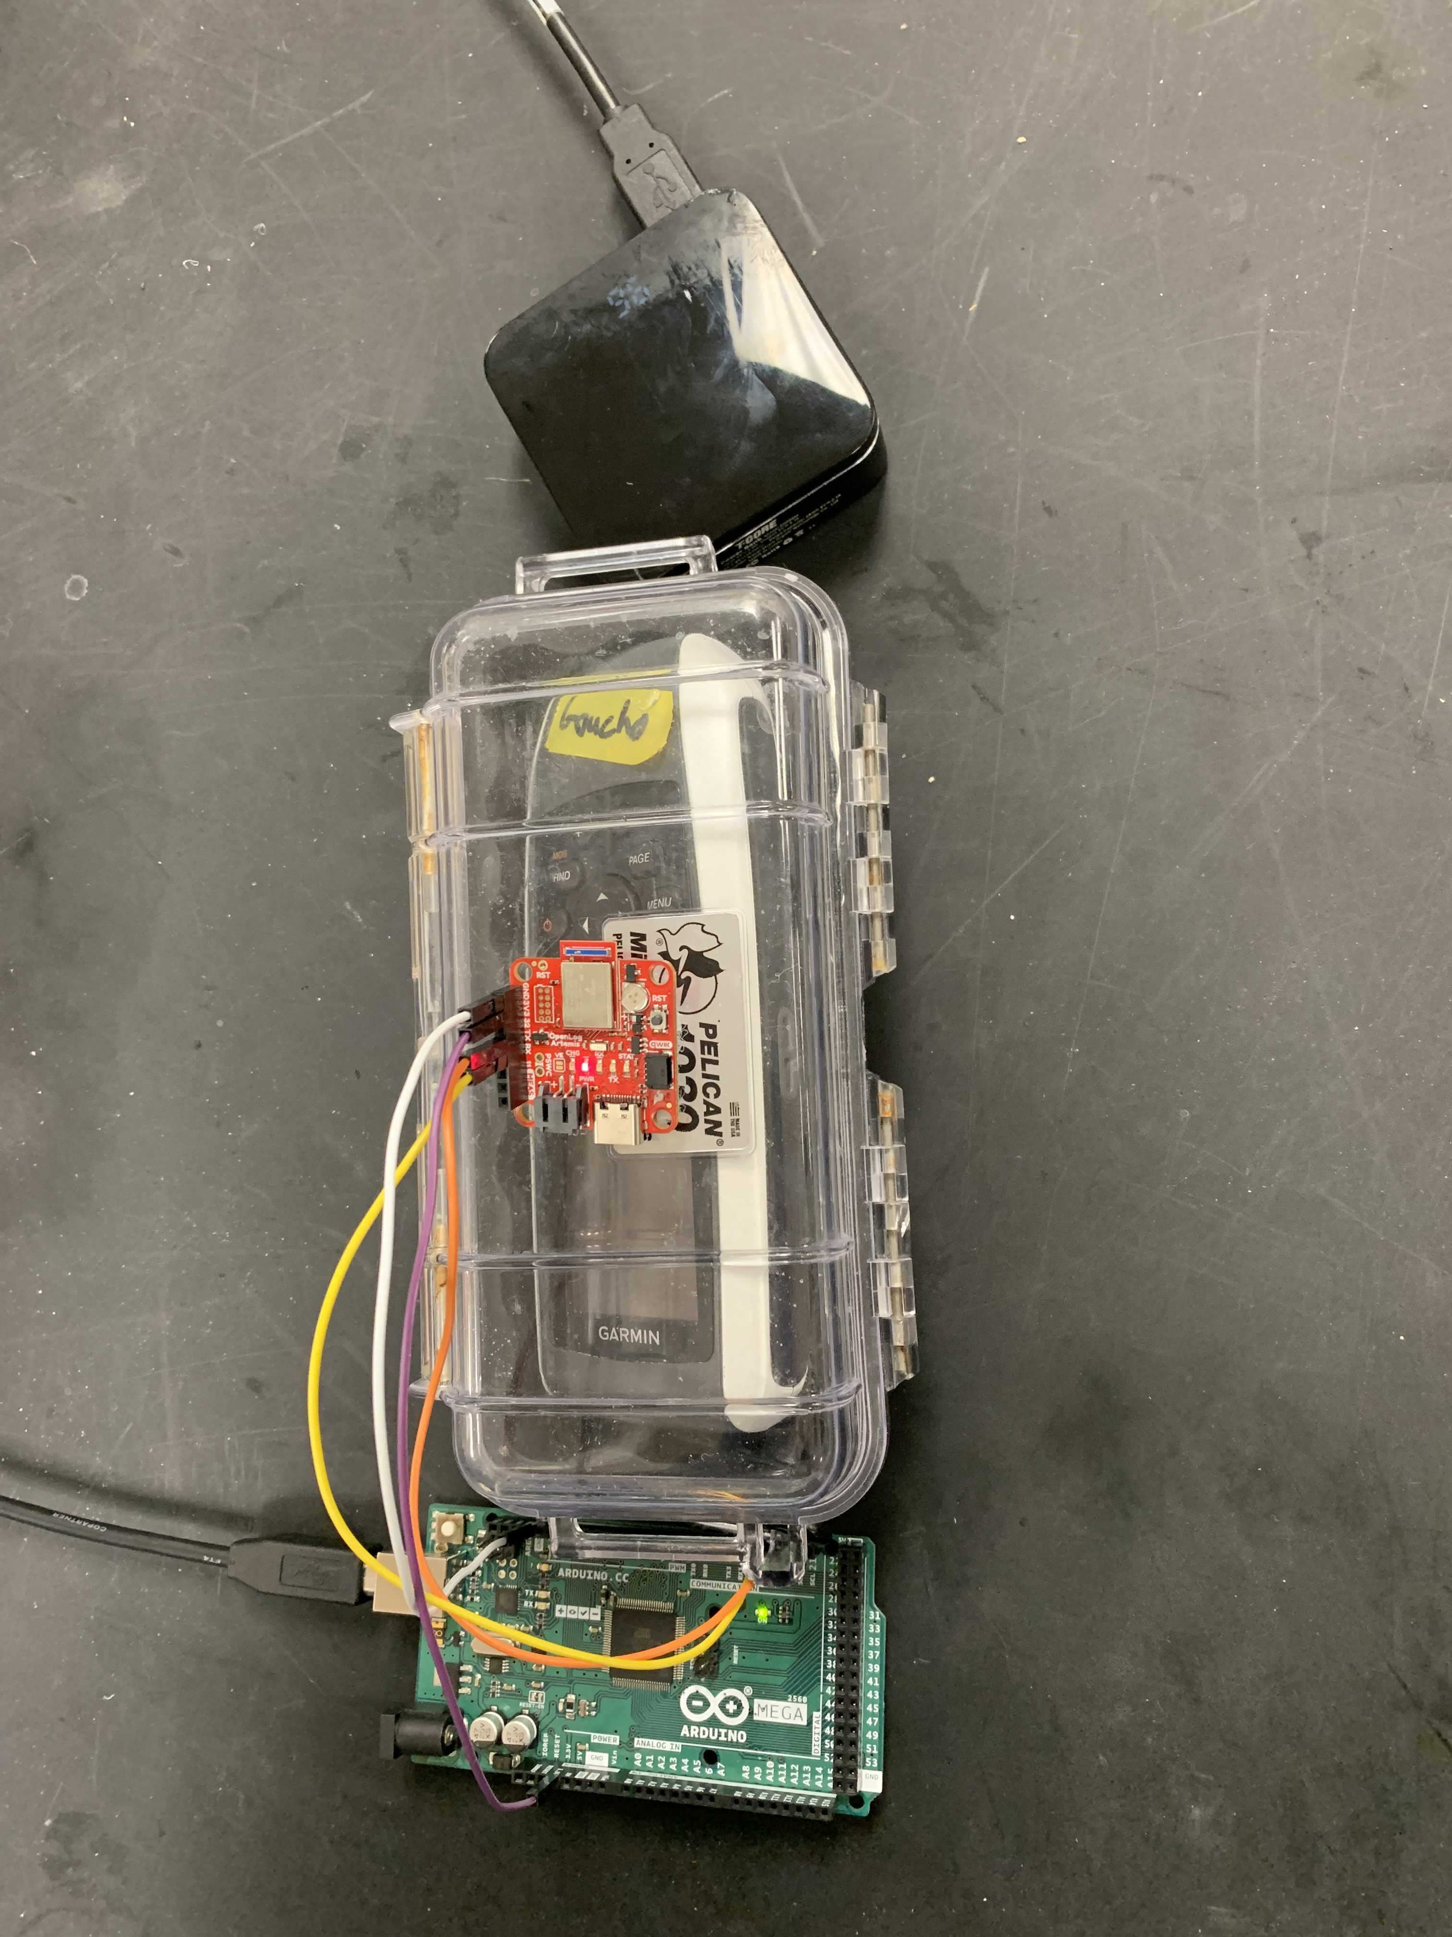
GPS and INS Testing
Megan Jadush
GPS
Portable Charger
Pelican Case
INS
Arduino

Slide 51
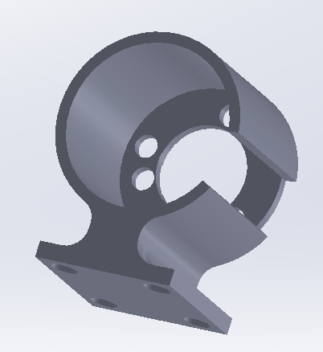
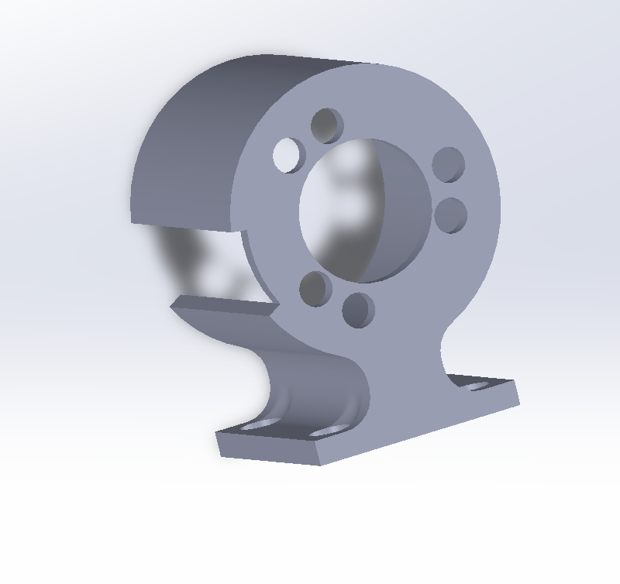
Angle Sensor Housing
Megan Jadush

Slide 52
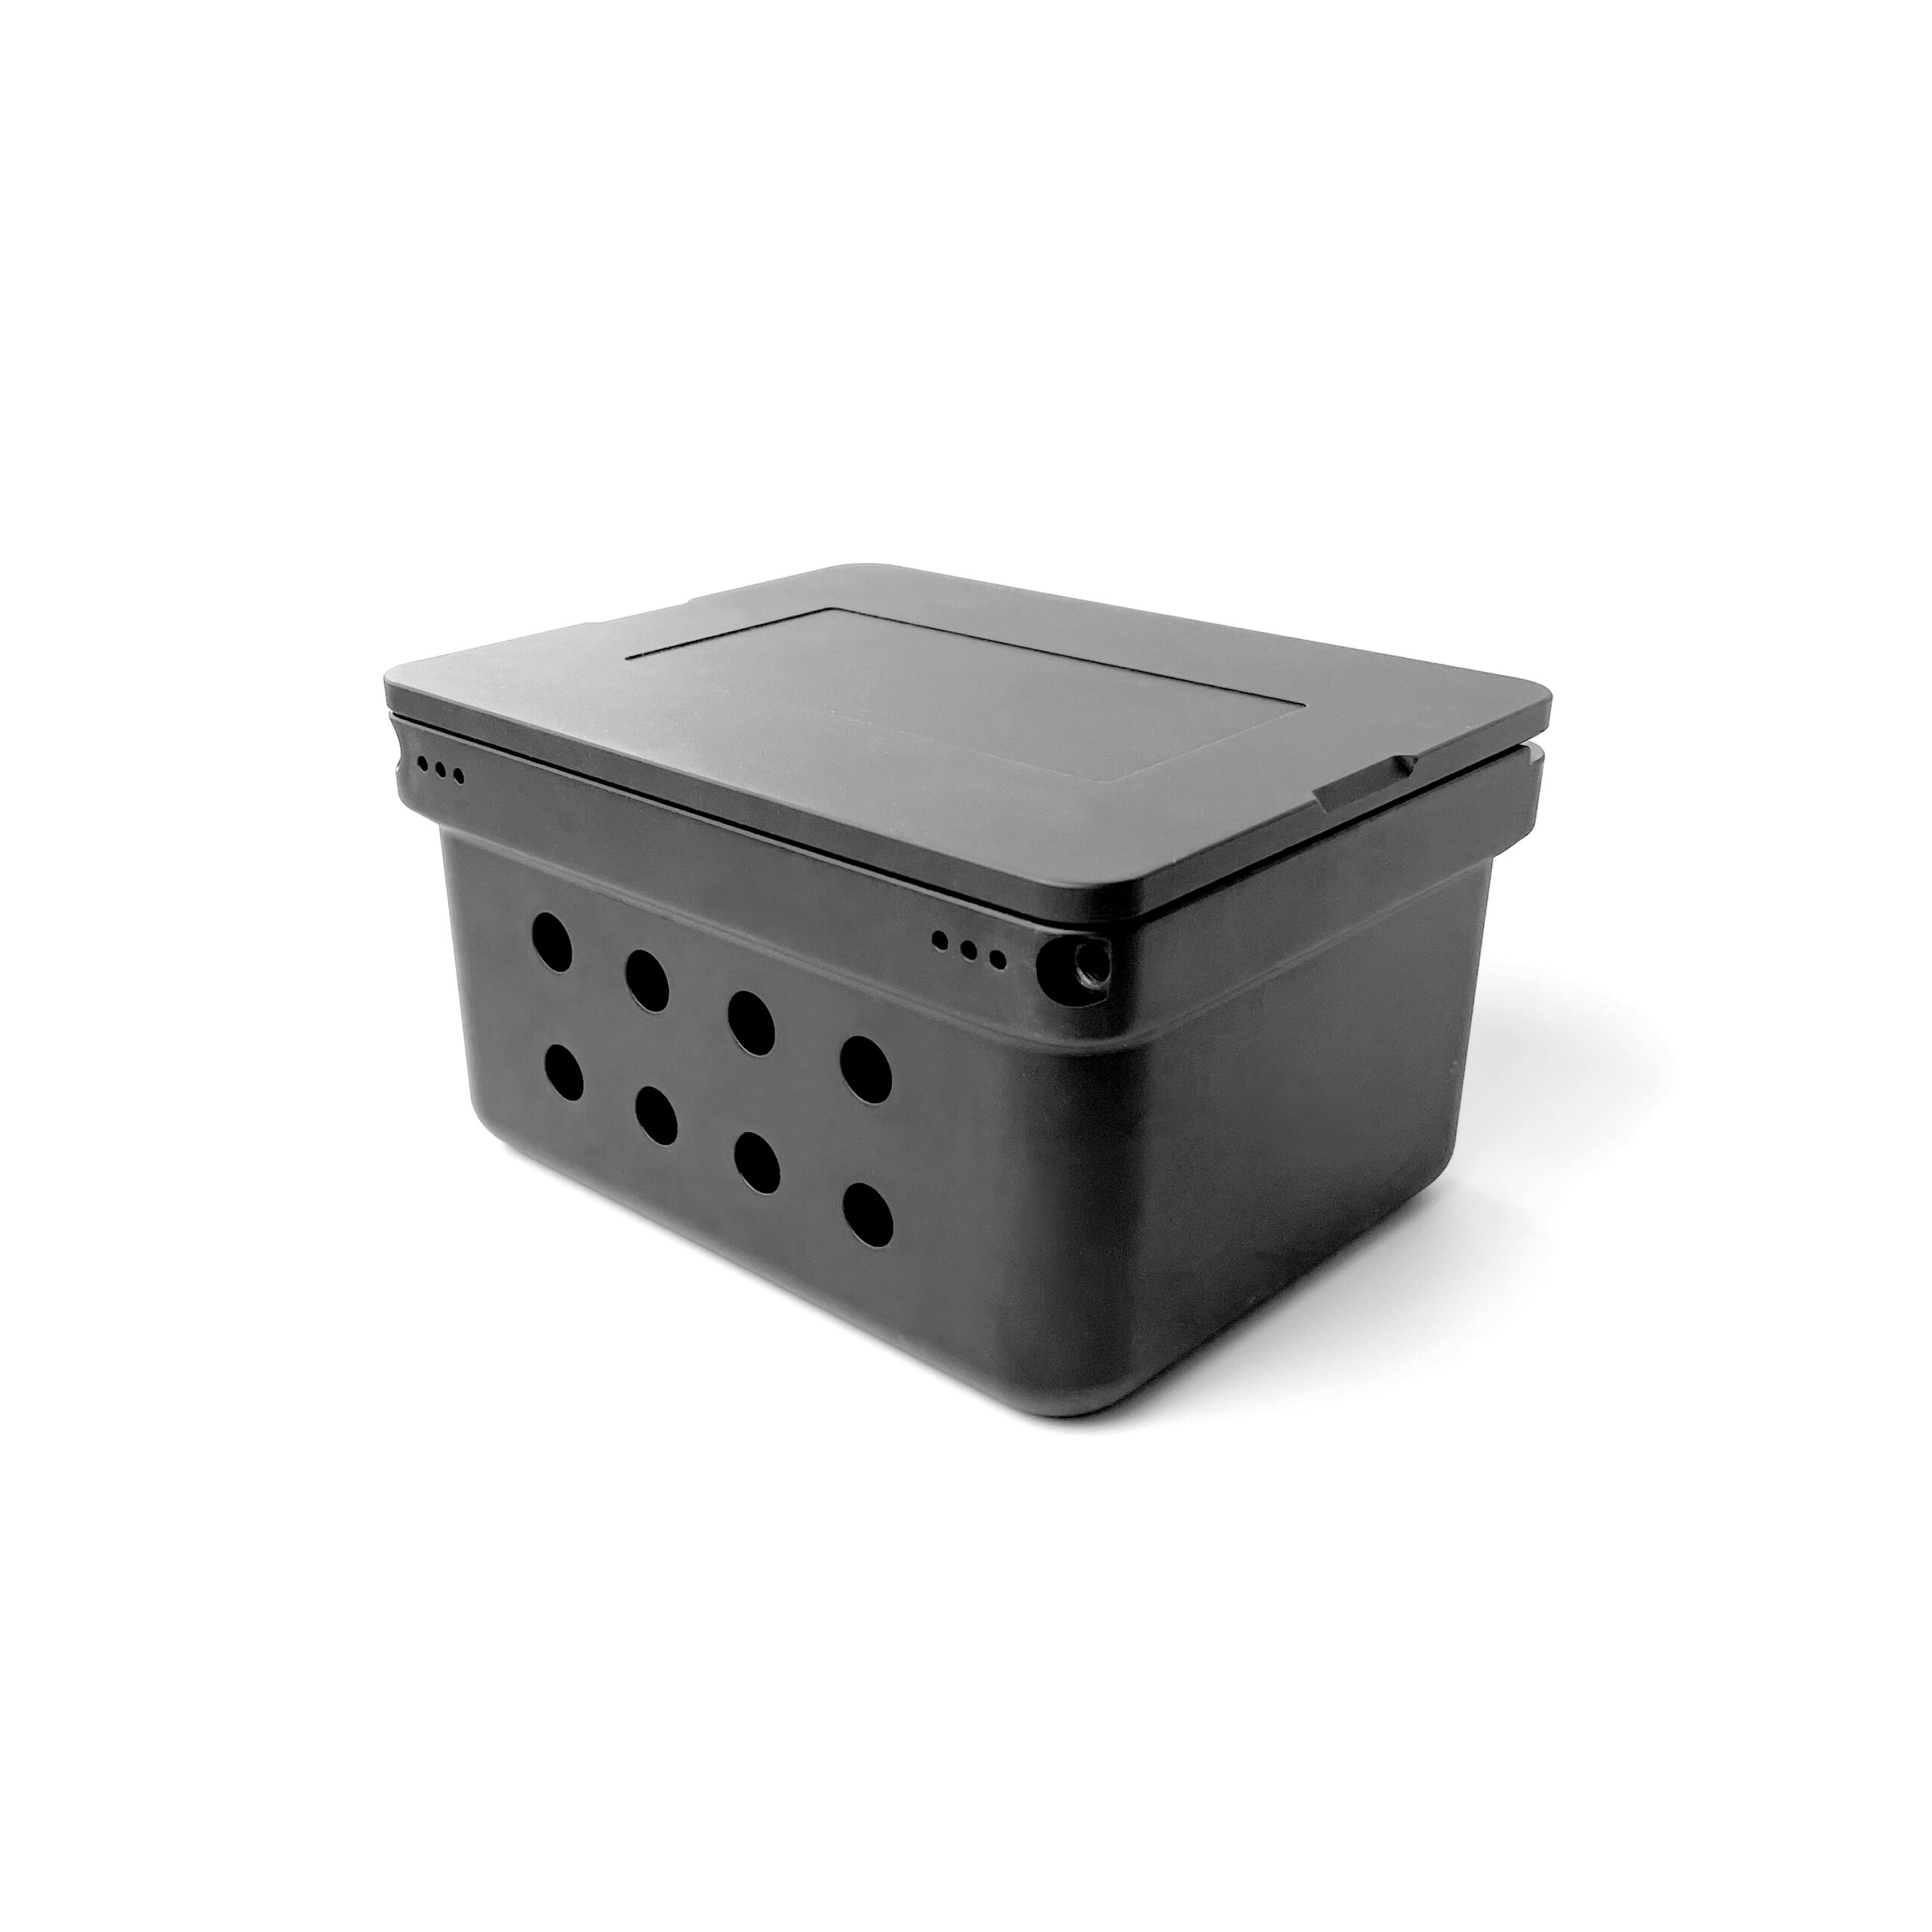
Megan Jadush
Materials Moving Forward
Below Surface System
Blue Robotics Watertight Box [5]

Slide 53
Back Up Slides

Slide 54
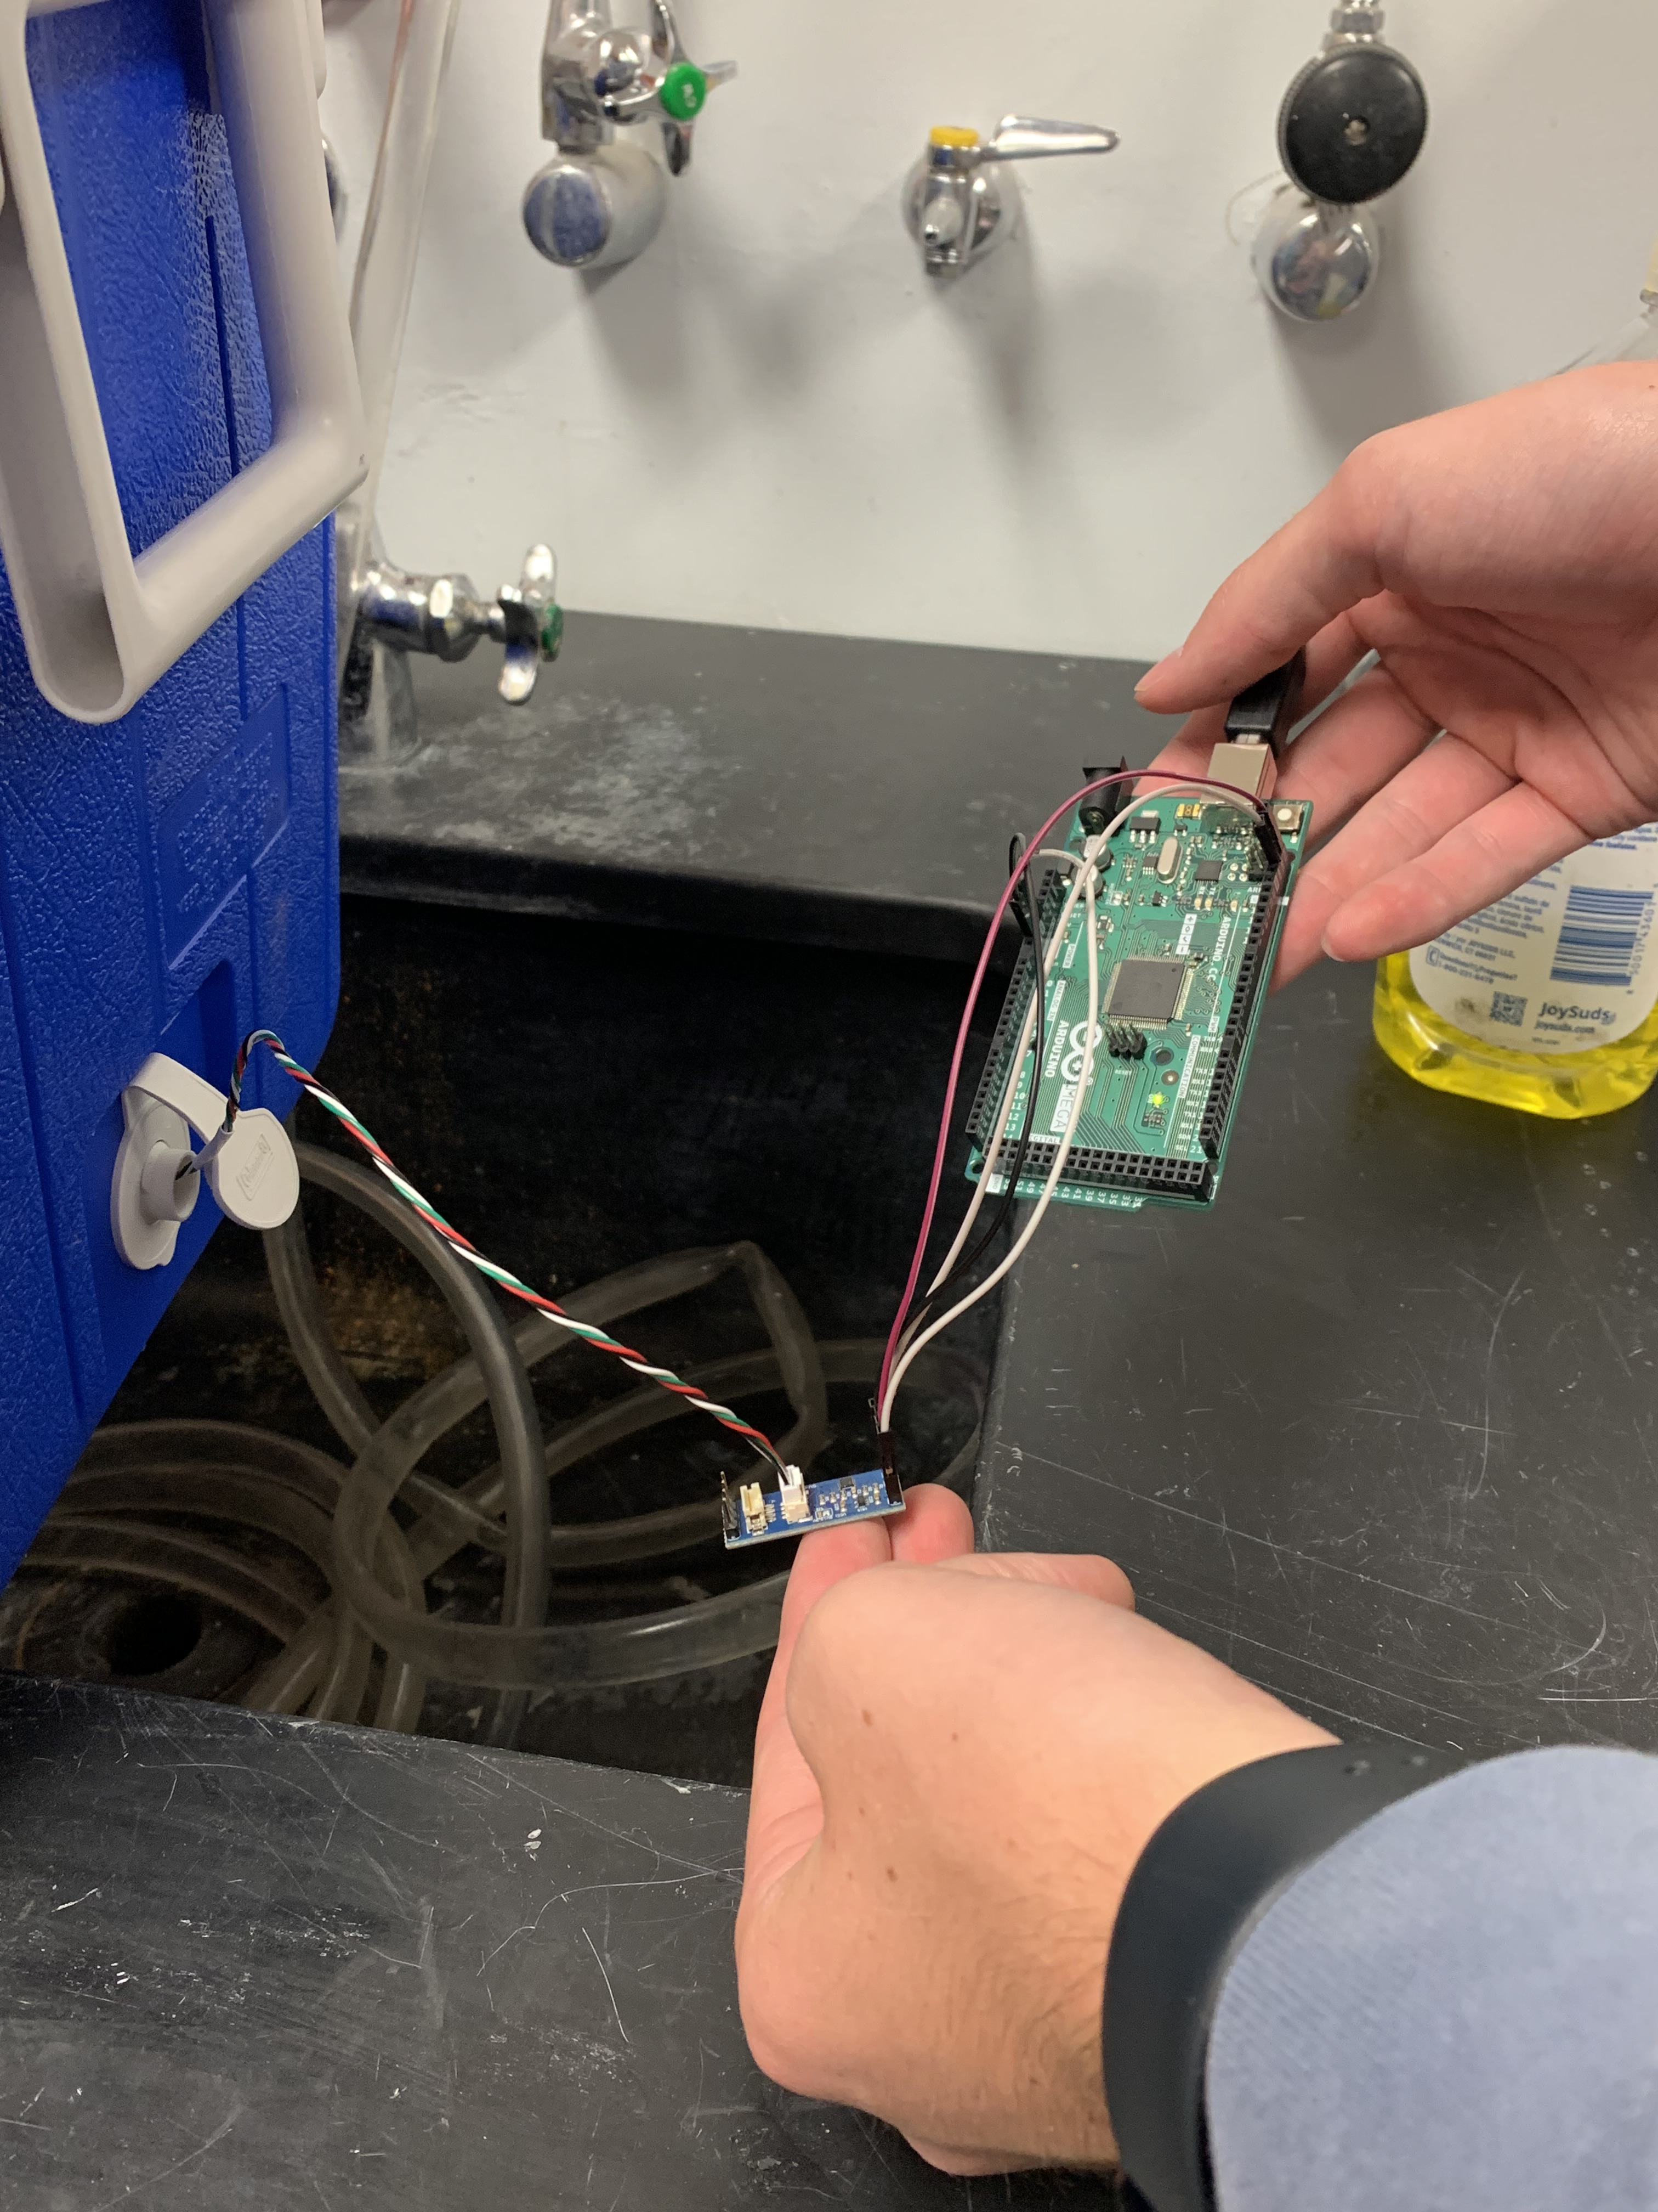
Barometer Testing
Megan Jadush
Arduino Mega 2560
Barometer
Level Converter

Slide 56
Angle Sensor Testing
Megan Jadush
Angle Sensor
Arduino Mega 2560

Slide 57
Targets
Natalie Boggess
Sensors
  Tracks diver global position (6 m.)
Power Sources
  Lasts ≥ 90 minutes
Structures
  Waterproof
  Transportable
Data
  Transmission (9600 baud)
  Storage (32 GB)

Slide 58





Slide Headline
Try to keep text at 16 pt minimum.
Try to put as few words as possible on the slide if you’re using for a presentation.
Mix and match the backgrounds as shown in this template or just use one throughout.
You can put department/unit logos in slide master at Horizontal 0.89” Vertical 6.44” From top left corner

Slide 59
Font Check
This is 10-point
This is 15–point Times
This is 20–point
This is 25–point
This is 30–point
This is 35–point
This is 40–point
This is 50–point
This is 60–point
This is 72–point
Notes:
Use at least 20-point font in Room A105, B134, and B136
Use at least 25-point font in Room B135

Slide 60
College of Engineering Color Palette
1 2 3 4
Pantone: PMS 195 C
RGB: 120, 47, 64
Hex: #782F40
CMYK:19, 90, 50, 55
1 2 3 4
Pantone: Black C
RGB: 0, 0, 0
Hex: #000000
CMYK:0, 0, 0, 100
Garnet
Black
1 2 3 4
RGB: 238, 118, 36
Hex: #EE7624
CMYK:2, 66, 99, 0
1 2 3 4
Pantone: PMS 000C
RGB: 255, 255, 255
Hex: #FFFFFF
CMYK: 0, 0, 0, 0
Fang
Orange
White
Notes:
Avoid 75% Black in B135

Slide 61
Accent Color Palette
1 2 3 4
RGB: 0, 59, 111
Hex: #003B6F
CMYK:
1 2 3 4
RGB: 0, 59, 111
Hex: #003B6F
CMYK:
1 2 3 4
RGB: 251, 236, 93
Hex: #FBEC5D
CMYK:
1 2 3 4
RGB: 219, 215, 210
Hex: #DBD7D2
CMYK:
1 2 3 4
RGB: 251, 236, 93
Hex: #FBEC5D
CMYK:
1 2 3 4
RGB: 219, 215, 210
Hex: #DBD7D2
CMYK:
Tardis Blue
Tardis Blue
Corn
Timberwolf
Corn
Timberwolf
1 2 3 4
RGB: 206, 0, 88
Hex: #CE0058
CMYK: 0, 100, 43, 12
1 2 3 4
RGB: 206, 0, 88
Hex: #CE0058
CMYK: 0, 100, 43, 12
1 2 3 4
RGB: 104, 40, 96
Hex: #682860
CMYK:
1 2 3 4
RGB: 220, 220, 220
Hex: #DCDCDC
CMYK:
Rubine Red
Rubine Red
Imperial
Gainsboro
1 2 3 4
RGB: 72, 146, 155
Hex: #48929b
CMYK:
1 2 3 4
RGB: 64, 224, 208
Hex: #40E0D0
CMYK:
1 2 3 4
RGB: 255, 139, 0
Hex: #FF8B00
CMYK:
Asagi-iro
Turquoise
American Orange
Notes:
Remove American orange add hyperlink grey
Make corn the last for b135
All work in 134 imperial move later
Tardis doesn’t work in b136

Slide 62
F7AB19
D67F15
EE7624
D64615
F73119
Analogous
6E3610
F0A16C
EE7624
6E4931
BASB1C
Monochromatic
A14508
4BED3B
EE7624
250CED
2010A1
Triad
A1470C
FF8C40
EE7624
0098A1
24E2ED
Complementary
28A164
2FED8D
EE7624
0848A1
1871ED
Split Complementary
EDAC2F
3BED93
EE7624
0C6AED
ED2F18
Double Split Complementary
ED660C
C7ED3B
EE7624
0CE1ED
A418ED
Square
BA7E09
87724A
EE7624
60EFCF
09BA61
Compound
https://color.adobe.com/create/color-wheel
AD551A
6E3610
EE7624
FA7625
D46820
Shades
Notes:
These are the variants that work well with Fang Orange. The bolded items show well on the projectors.

Slide 63
85412D
8F3831
782f40
8F3176
792D85
Analogous
C44D69
8E626D
782F40
C48796
451B25
Monochromatic
C43959
78743B
782F40
236178
43A2C4
Triad
C43959
C46078
782F40
25C43D
2F783A
Complementary
93C460
577835
782F40
39C49D
297861
Split Complementary
784435
5A783B
782F40
237860
6E2978
Double Split Complementary
782337
78683b
782F40
237830
293978
Square
AB4D32
DEBAAF
782F40
5D8555
70AB32
Compound
https://color.adobe.com/create/color-wheel
38161E
C44D69
782F40
853447
5E2532
Shades

Slide 64
A105
A105
B135 Stage Left
B135 Stage Right
B136
B134, A105
B135

Slide 65
Border Line
Border Line
Border Line
Center of White Space
Center of Slide
Middle of Slide
Middle of White Space
Edge of Branding
Border Line
Notes:
Vertical lines from top down.
Borderline and top of title. (0.5 inch)
Center of Slide (0 inch y-direction for the entire slide)
Center of Design Content (0 inch y-direction considering the title, footer, and negative space)
Bottom of Design Content (0.25 in gap to the footer. 0.75 to the bottom of the screen)
Horizontal lines from left to right
Borderline (0.5 inch)
Center of design content.
Center of slide (0 inch y-direction for the entire slide)
Borderline (0.125 inch all around)

